Slide 1
The Molecular Interstellar Medium at Low Metallicities
Alberto D. Bolatto
University of Maryland, College Park

Slide 2
Most galaxies are low mass and low metallicity (also, outer galactic disks)
SF law?
SF feedback?
AGN feedback?
Robertson & Kravtsov (2008)
Gnedin, Tassis, & Kravtsov (2009)
Narayanan et al. (2008)
Krumholz et al. (2008, 2009)
Baldry et al. (2008)

Slide 3
Outline
Background: The structure of molecular clouds at low metallicities
Overview of observations
Relation between molecular gas and star formation
Perspectives for ALMA

Slide 4
The Structure of the Molecular ISM
HST imaging of the clouds in the Carina Nebula
N. Smith

Slide 5
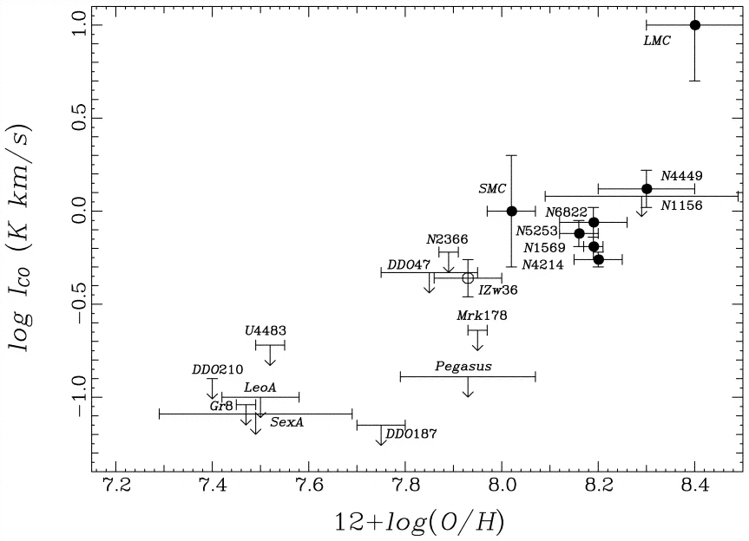
No CO but active star formation?
Less C and O ⇒ slower CO formation
Less dust ⇒ faster CO photodissociation
Taylor et al. (1998)
H
H
Homonuclear, no permanent dipole. Ground quadupole transition E~500 K
No CO detections
C
O
Chemically favored in dark clouds. Ground dipole transtion E~5.5 K

Slide 6
Structure of Photodissociation Regions
Dust controls UV extinction and physical sizes
HII
HI
H₂
Self & cross shielded
C⁺
C⁺ + e⁻ → C
C⁺ + S → C + S⁺
C + γ → C⁺
C⁰
CO
C + OH → CO + H
CO + γ → C + O
increasing A_{v}
A_{v}~1
A_{v}~2
Tielens & Hollenbach (1985)
HII region
PDR
Dark cloud
T~10,000 K
T ~ 1,000 to 10 K
T ~ 10 K

Slide 7
Clouds have substructure: clumpiness
Widespread [C II] and [C I] emission
Direct evidence of clumping in all scales
(e.g., Stutzki et al. 1988; Marscher et al. 1994)
C⁺
C
H₂
CO

Slide 8
Clumpiness and metallicity
As metallicity and dust-to-gas ratios decrease, A_{v}~1 moves deeper into clumps of constant column density
CO disappears when A_{v}<2 through a clump, but H₂ exists to much lower extinctions
The relative amount of CO and H₂ is set by the distribution of column densities in the ISM
H₂
C⁺
Maloney & Black (1988), Bolatto et al. (1999), Röllig et al. (2006)
CO
Z

Slide 9
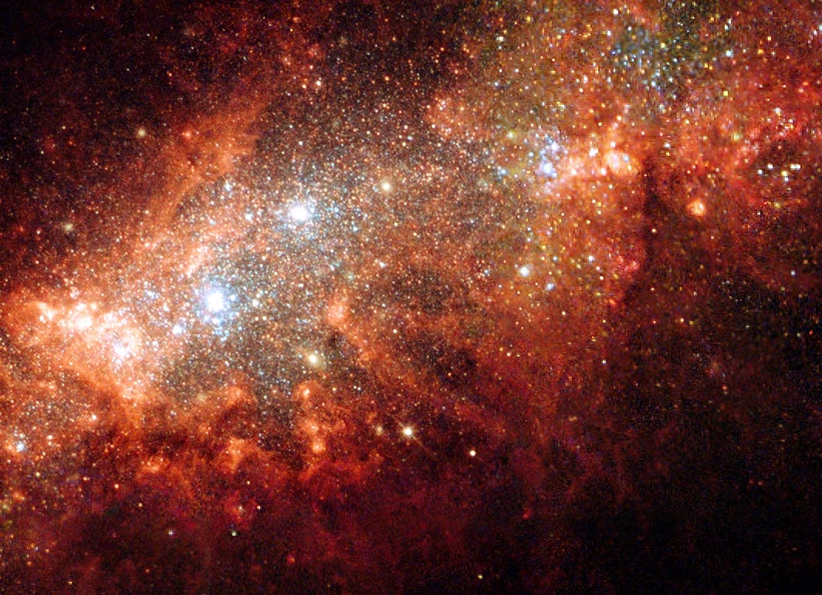
Observations
HST imaging of the starburst in NGC 1569 (U, V, R+Hα)
P. Anders

Slide 10
Real Molecular Clouds
Self similar
Chaotic
Fractal
Complex
But GMCs obey simple scaling relations (Larson 1979, 1981; Solomon et al. 1978)
Jackson et al. (2006)
¹³CO 1-0
GRS datacube at l=24°
659×0.2 km/s channels
2.2° × 2° field

Slide 11
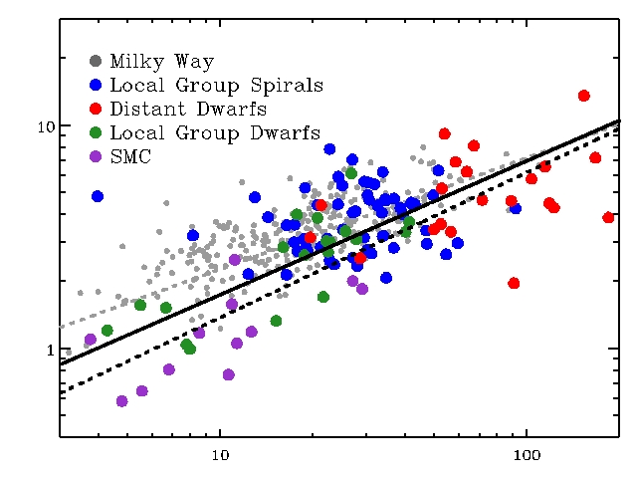
The Size-Line Width Relation in Galaxies
Dwarfs fairly consistent with both Milky Way and local group spirals:
- for σ ~R^{0.5}, Σ_{dwarf} ~ 85 M_{sun}/pc²
Worst outliers (factor ~ 2): small clouds in SMC:
- low surface density?
- increased B-field?
(e.g. Bot+ 07)
- clouds not virialized?
Main conclusion: broad agreement in CO-based GMC props…
Line Width [km s⁻¹]
dwarf GMCs: σ = 0.31 R_{pc}^{0.65} km/s (recall M.W.: σ = 0.72 R_{pc}^{0.5} km/s)
Radius [parsecs]
CPROPS methodology: Rosolowsky & Leroy (2006)
Bolatto, Leroy, et al. (2008)
Notes:
Good agreement!
The implication is that surface density is similar across GMCs in all systems!
Worst outliers are in the SMC, lowest metallicity, more alike to the outer galaxy disks

Slide 12
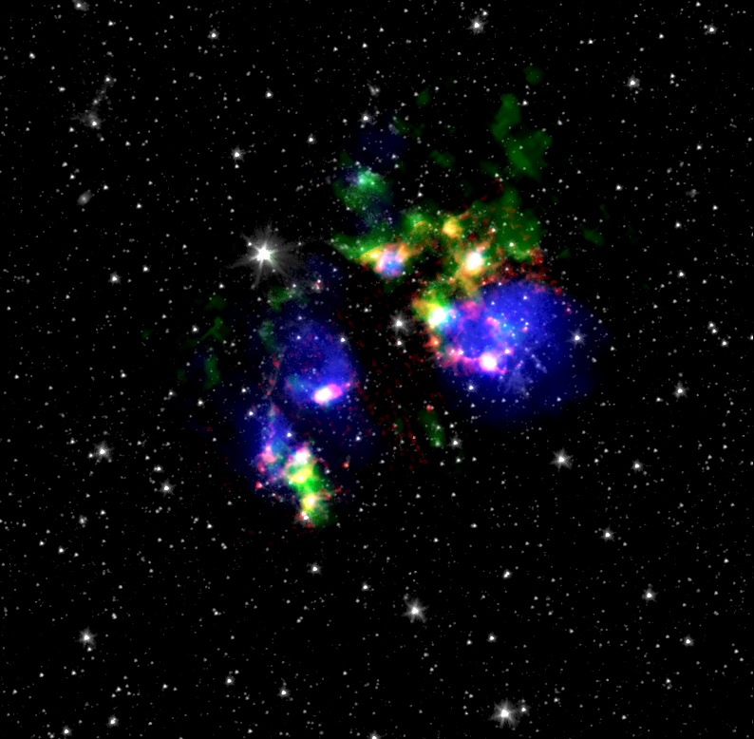
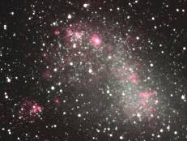
The SMC in the midIR
N76
3.6 um = Blue
8.0 um = Green
24 um = Red
[SIII] 33.5um= Blue
H2 S(0) 28 um = Green
UIB 11.3um = Red
3.6 um = Gray
N66/NGC 346 (33 O stars)
N83/N84
N22

Slide 13
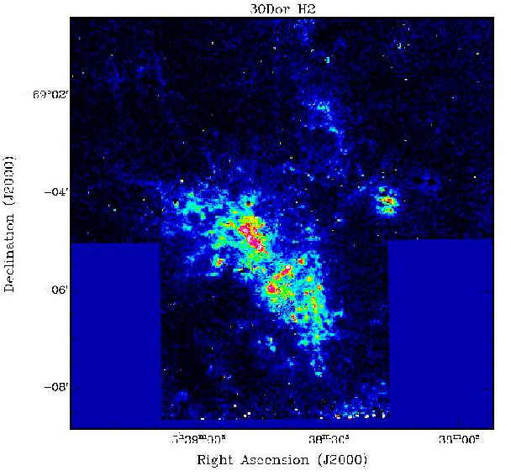
Near-IR H₂ imaging
N159 in the LMC
30 Doradus in the LMC
H₂ pointings over CO (Pak et al. 1998)
Rubio et al. (in prep.)

Slide 14
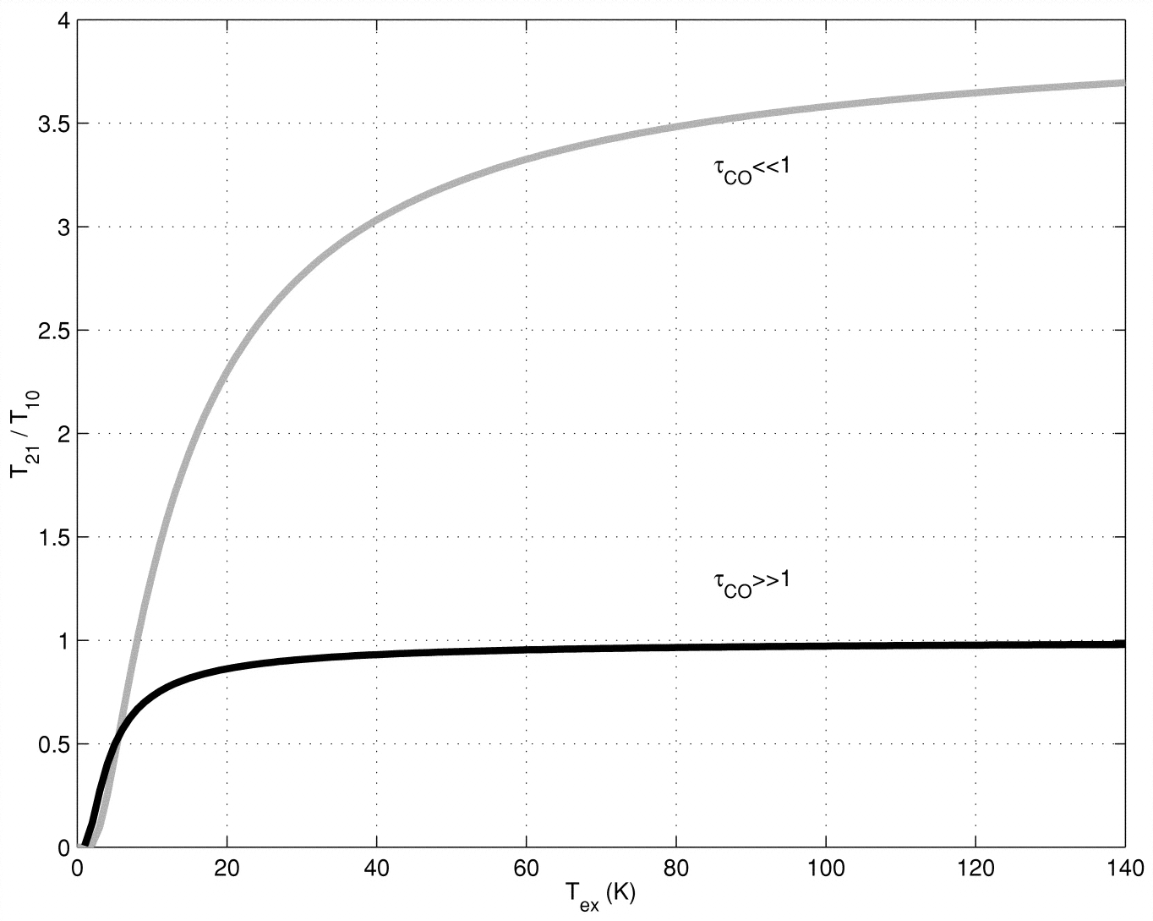
Optically thin CO emission in envelopes
Bolatto et al. (2000)

Slide 15
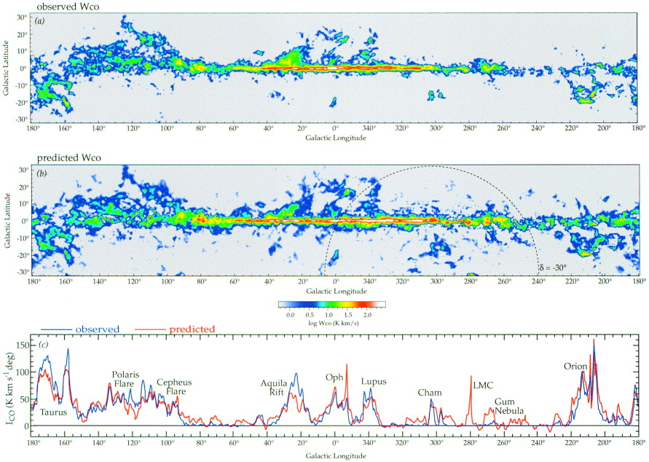
Using dust to trace H₂
CO is biased at low metallicities . FIR dust emission offers another view.
Traces the total gas (HI + H2) column. Probably better, at least ‘differently biased.’
In the Galaxy, matches Gamma Ray and CO results well.
In the SMC, IRAS suggests much more H₂ than seen from CO (Israel 1997)
Method:
Dame, Hartmann, and Thaddeus (2001)
Σ_{H2} = (Σ_{dust} × DGR⁻¹)- Σ_{HI}
Estimate the dust surface density using FIR emission (need two bands to make a temperature estimate).
Measure the dust-to-gas ratio from the ratio of dust to atomic gas away from the molecular line emission but near enough to calibrate out galactic variations.
From the beautiful ATCA+Parkes HI map by Stanimirovic et al. (1999), the distribution of atomic gas is known.

Slide 16
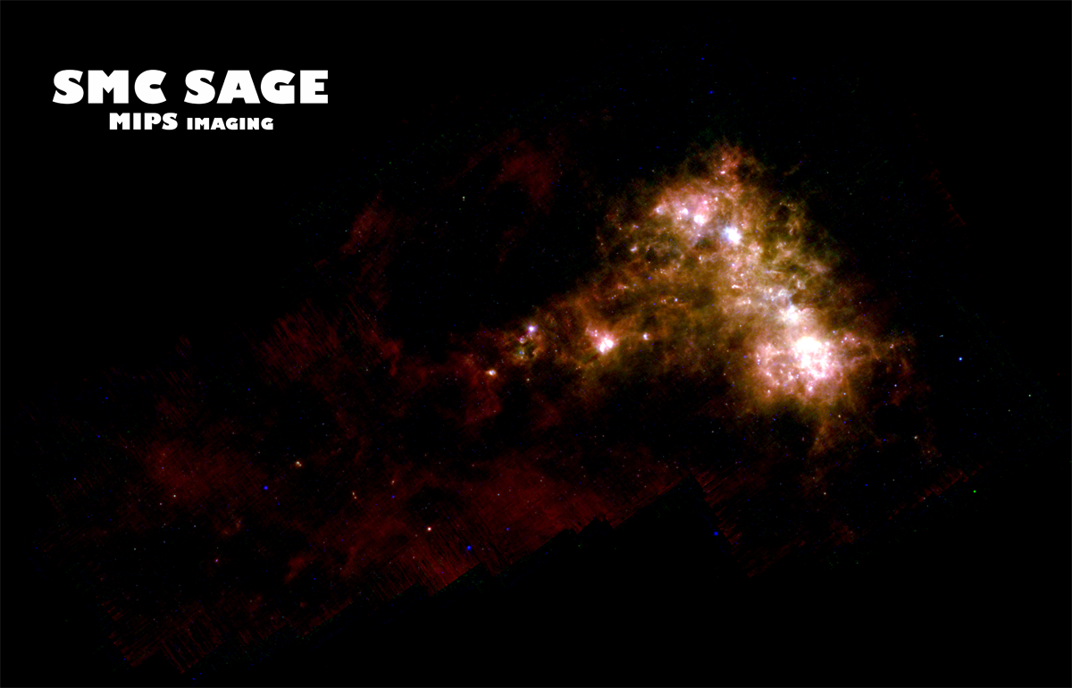
Dust emission at 24, 70, and 160 μm from the SMC:
SMC-SAGE (PI: K. Gordon)+S3MC (Bolatto+ 07)

Slide 17
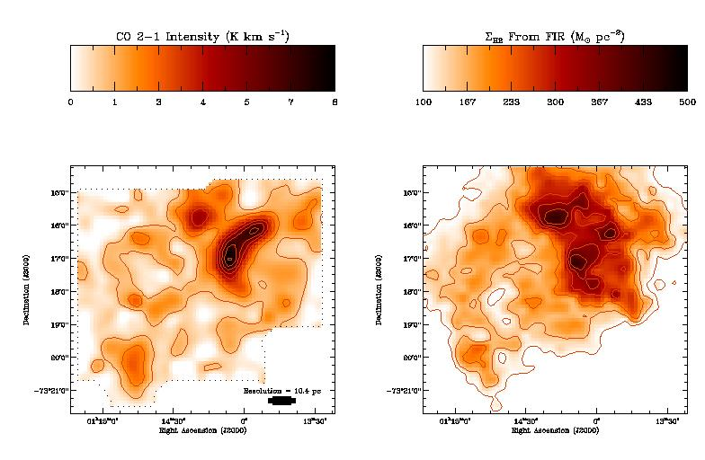
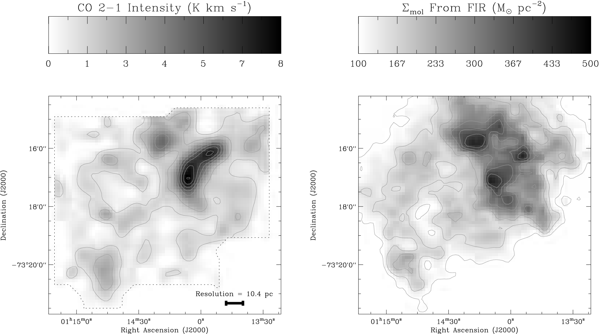
Imaging of extended molecular envelopes
Leroy et al. (2009)

Slide 18
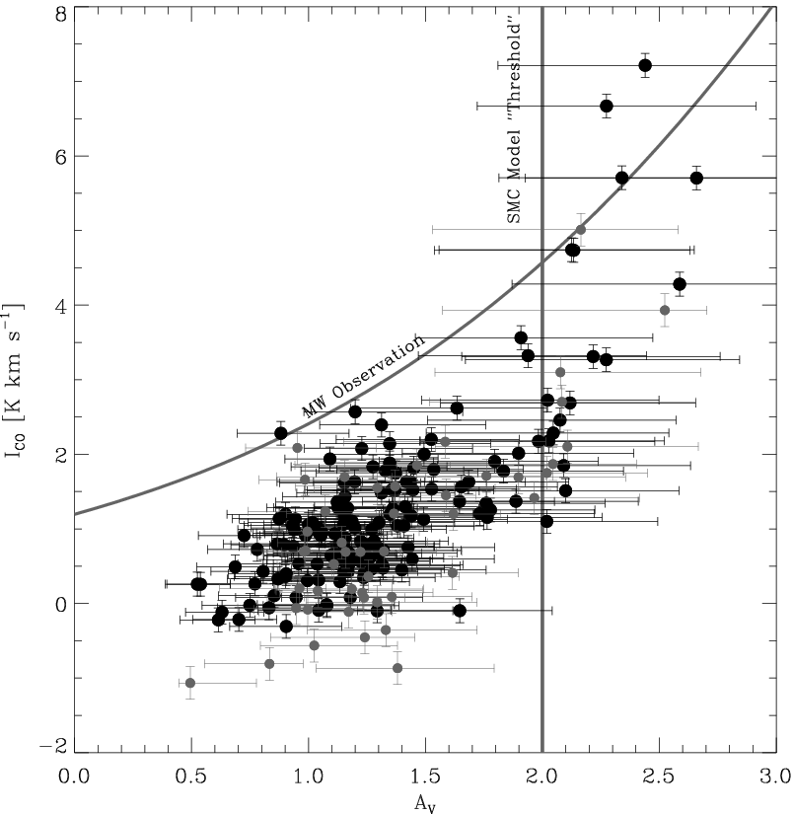
Relation between CO and A_{v} at Z~1/5 Z
Bright CO emission is found at A_{v} ≥ 2
Below A_{v} ≤ 1, CO emission is extremely weak
A_{v}=1 implies N(H)~10²² cm⁻²
Clouds are ~50% more extended than their CO emission
Leroy et al. (2009)

Slide 19
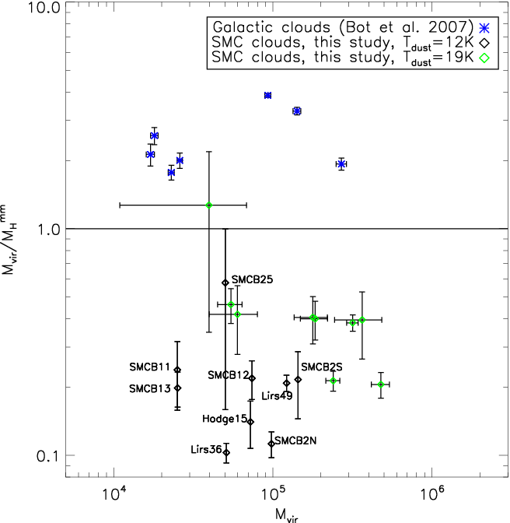
Colder dust modeling at longer wavelengths
LABOCA 870 um bolometer mapping of the South West region of the SMC
(also Rubio et al. 2004, Bot et al. 2007)
870 um emission
CO contours
160 um contours
Bot et al. (2009)

Slide 20
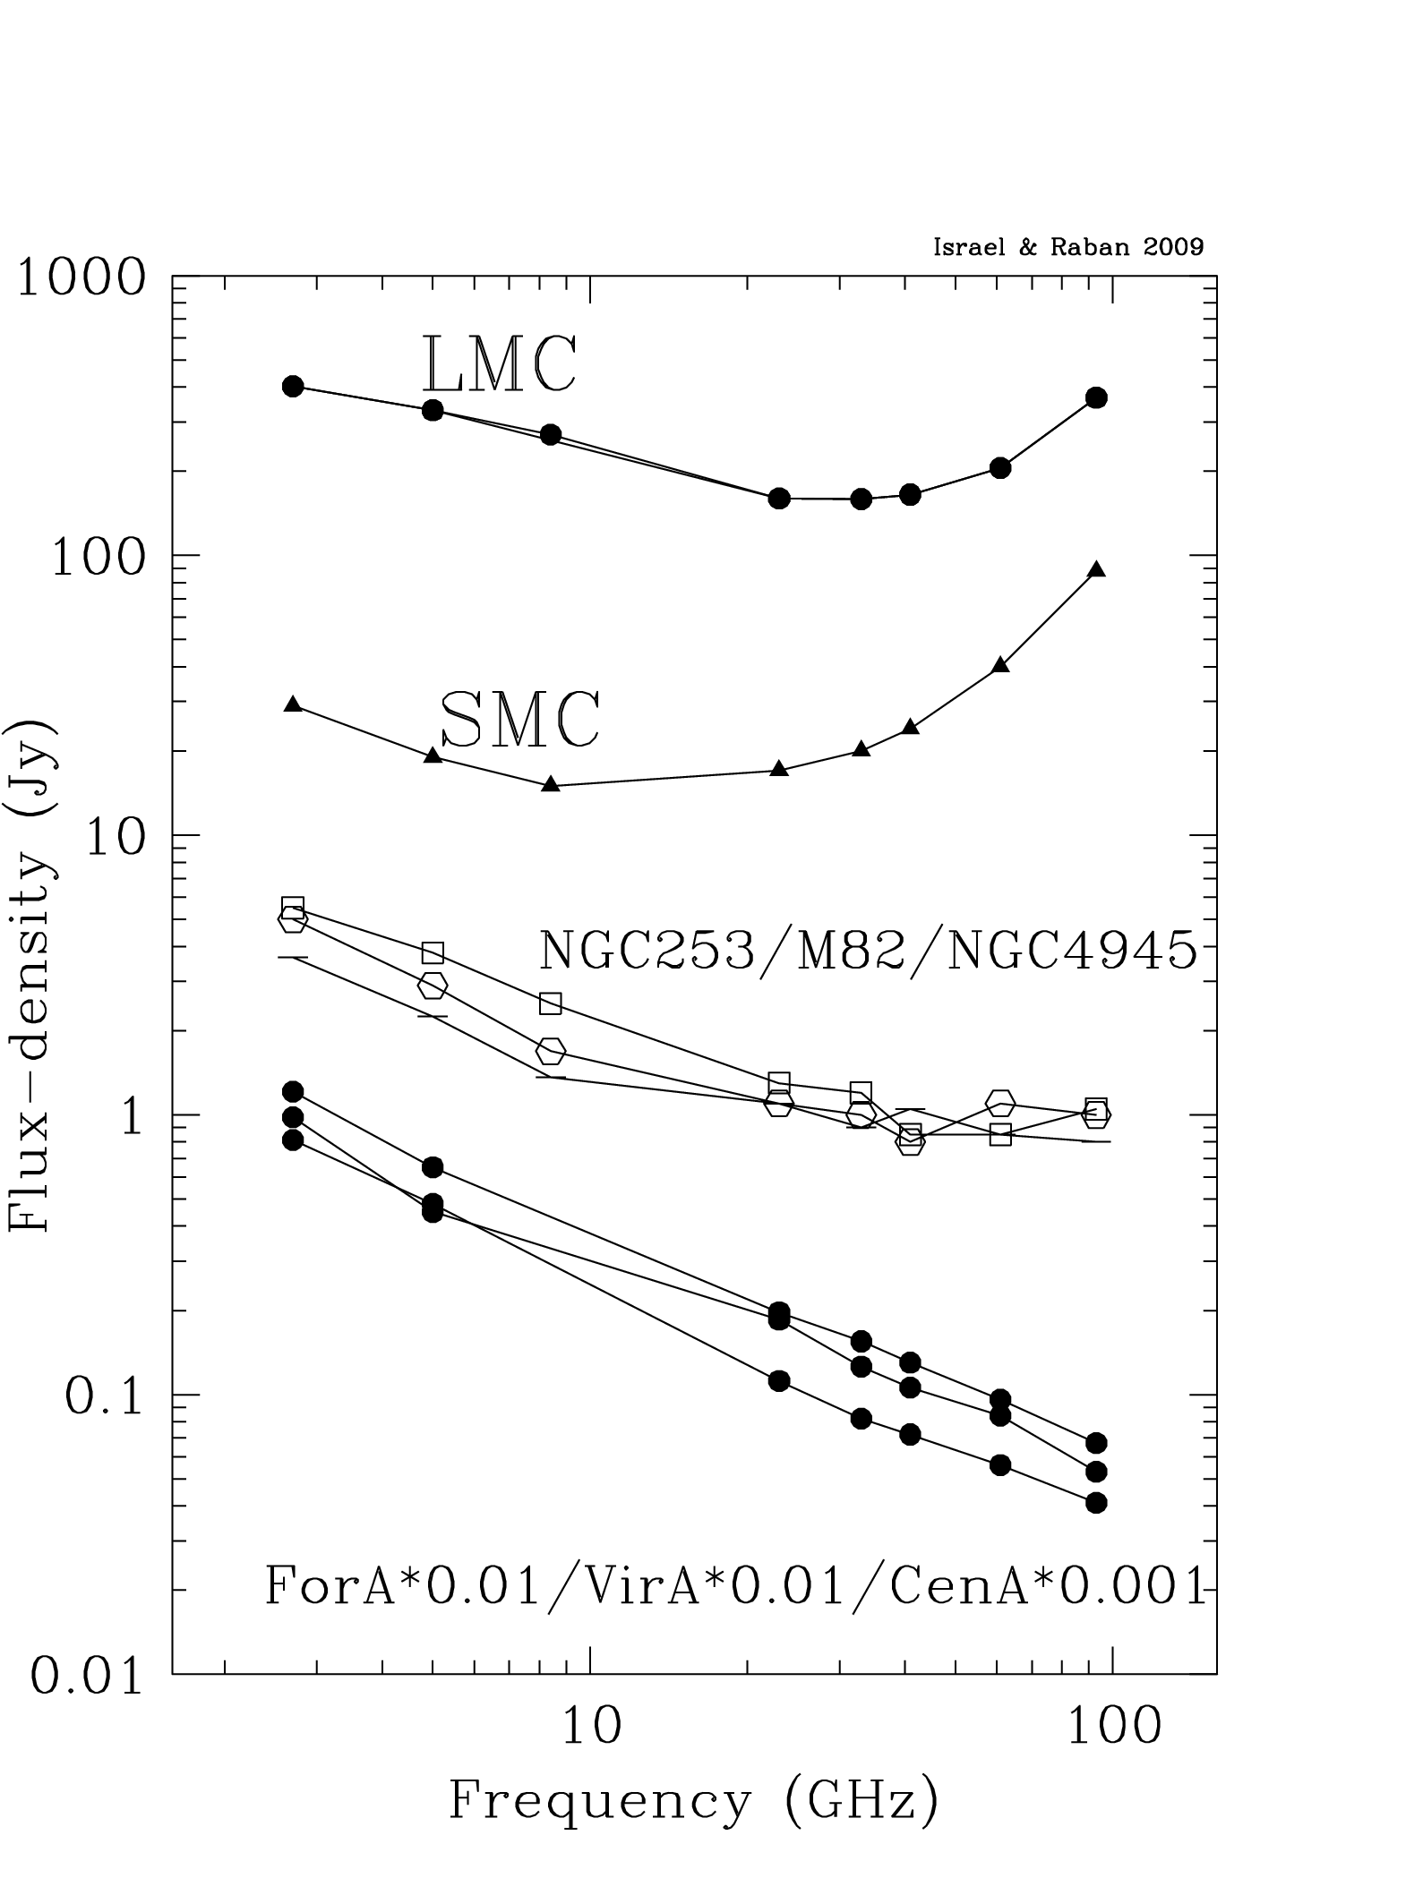
Long wavelength excess at low metallicites?
Long wavelength Rayleigh-Jeans excess is present in both LMC and SMC
Exotic dust properties?
Very cold dust: requires huge dust mass (likely disallowed by metallicity constraints)
Out of equilibrium VSG dust emission? (Draine & Anderson 1985; Draine & Li 2001)
Israel & Raban (in prep.)
See also Galliano et al. (2005); Bolatto et al. (2000)

Slide 21
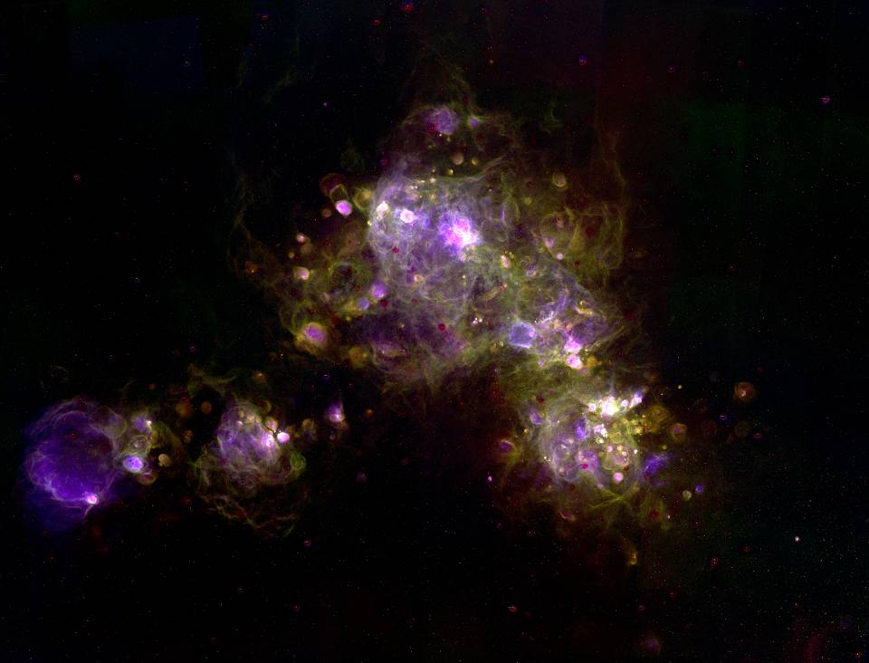
The Star Formation Law
CTIO emission line imaging of the SMC (OIII, SII, Hα)
C. Smith, F. Winkler, & the MCELS team

Slide 22
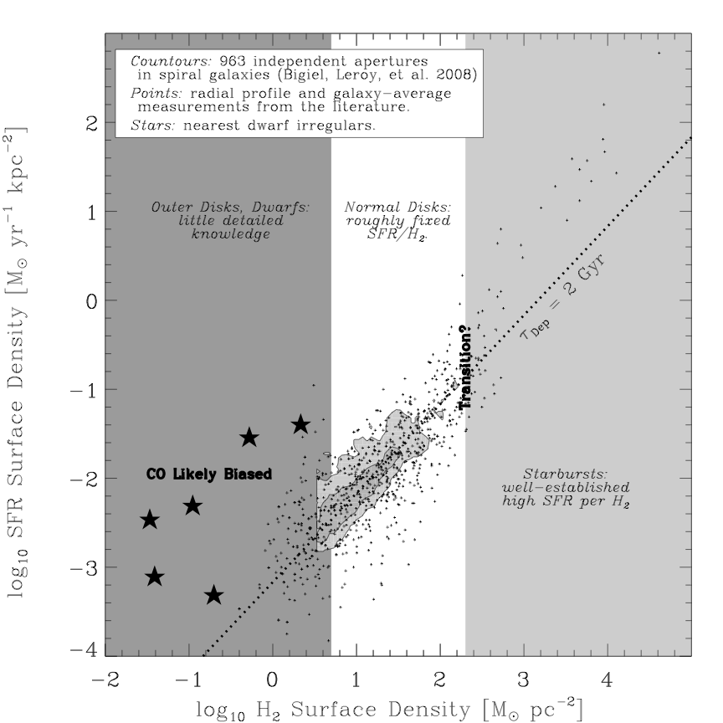
Low metallicity and the star formation laws
Low metallicity local dwarf galaxies and outer galaxy disks are some of the most discrepant objects when placed on the molecular star formation law
Is this the result of imperfect estimates of H₂ surface densities?
SMC
Bigiel et al. (2008)

Slide 23
Background: Results from 2007 analysis using S³MC
Using 100 and 160 um to avoid influence of stochastic heating. Limited to ~4’ (80 pc) by IRAS.
Using Dale & Helou (2000) models to account for multiple temperature comps.
DGR determined locally.
Conclusions: Large Xco correction (30-60 times Galactic). M_{H2}~3x10⁷ M_{sun} total molecular mass, compared to M_{HI}~2x10⁸ M_{sun} . Similar pressure relation as large spirals.
Leroy et al. (2007)

Slide 24
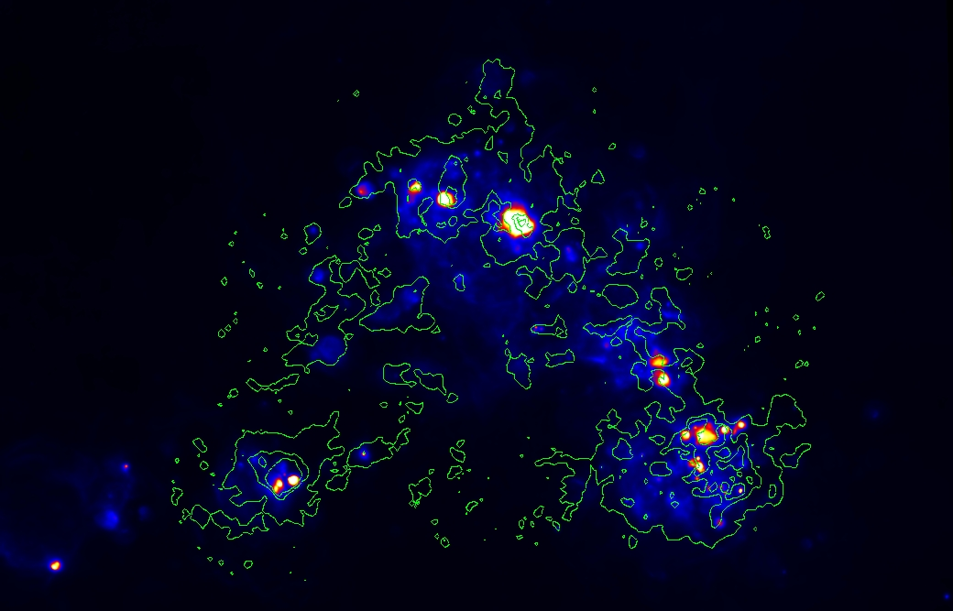
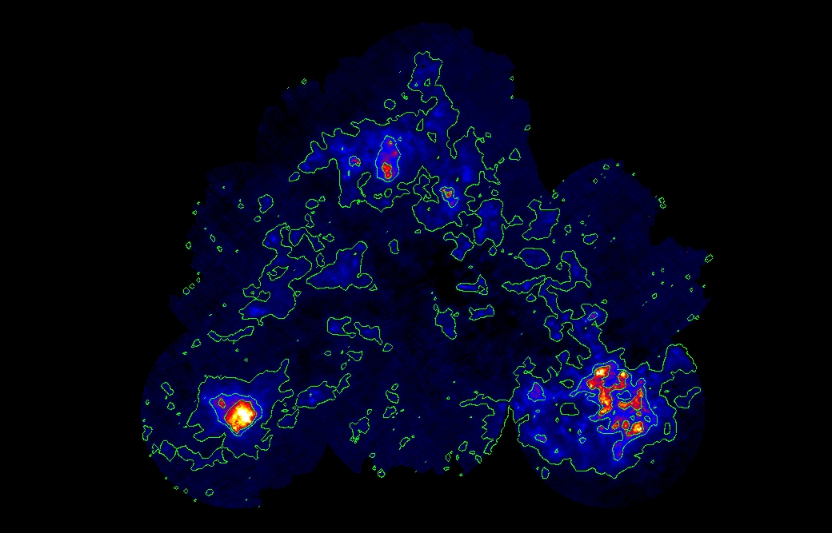
Fraction of obscured SF according to the Calzetti et al. (2007) calibration is localized and small: we use Hα+24 um but most of the correlation comes from Hα

Slide 25
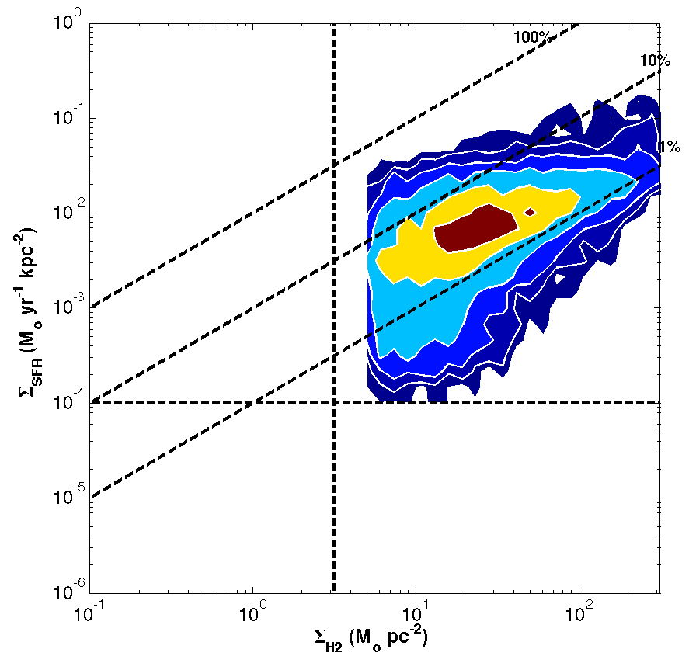
The H₂ Schmidt law in the SMC
Normal spirals
Bigiel et al. (2008)
The SMC, at Z~0.2 Z and 10 pc resolution, logarithmic contours

Slide 26
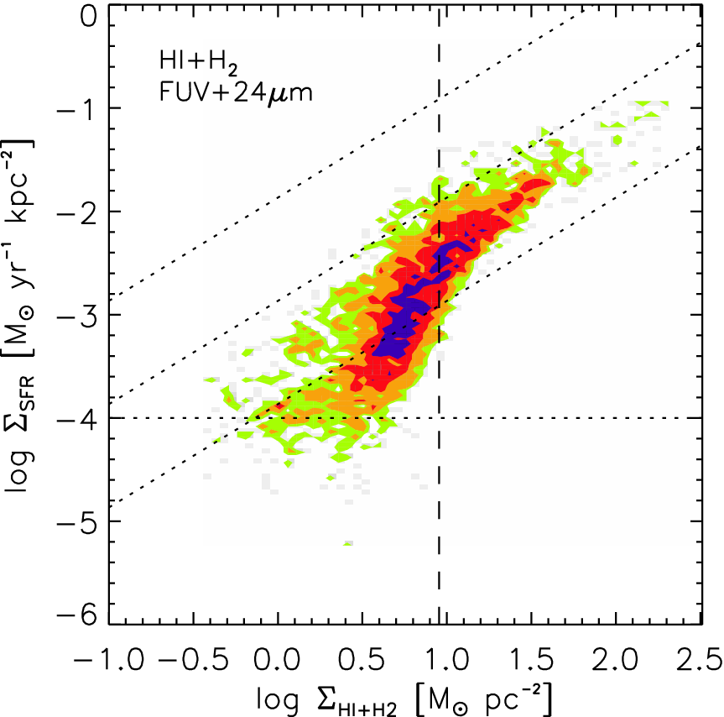
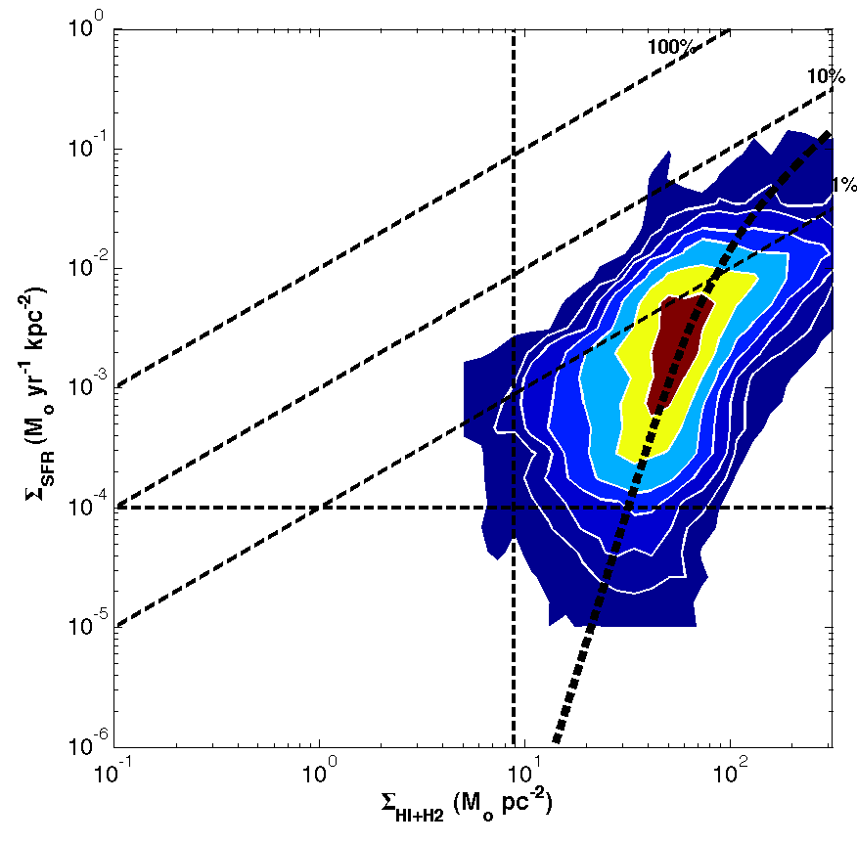
The total gas Schmidt law in the SMC
Normal spirals
Bigiel et al. (2008)
The SMC, at Z~0.2 Z and 10 pc resolution
KMT09 for Z~0.2Z

Slide 27
Understanding the atomic to molecular transition
Gnedin, Tassis, & Kravtsov (2009)

Slide 28
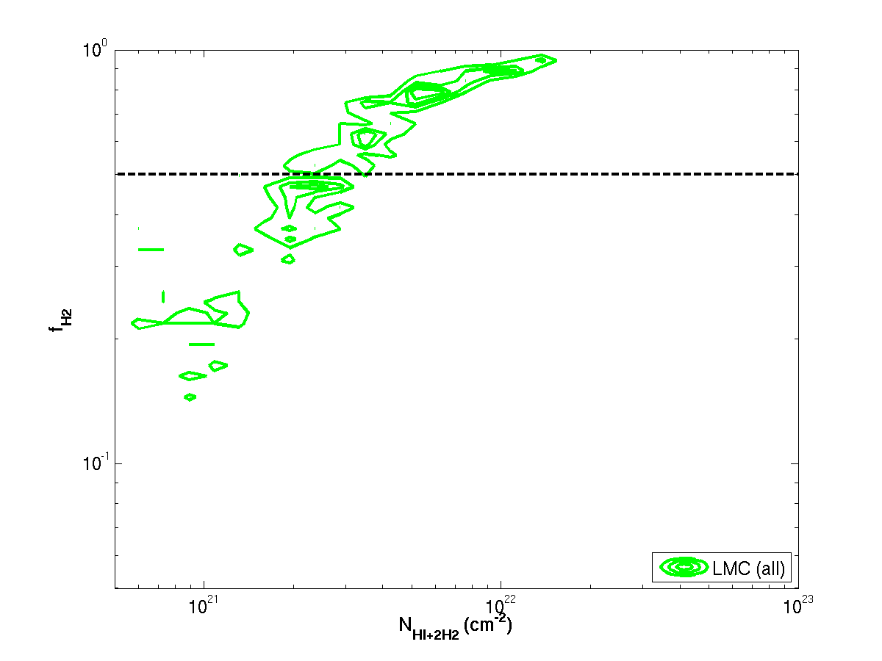
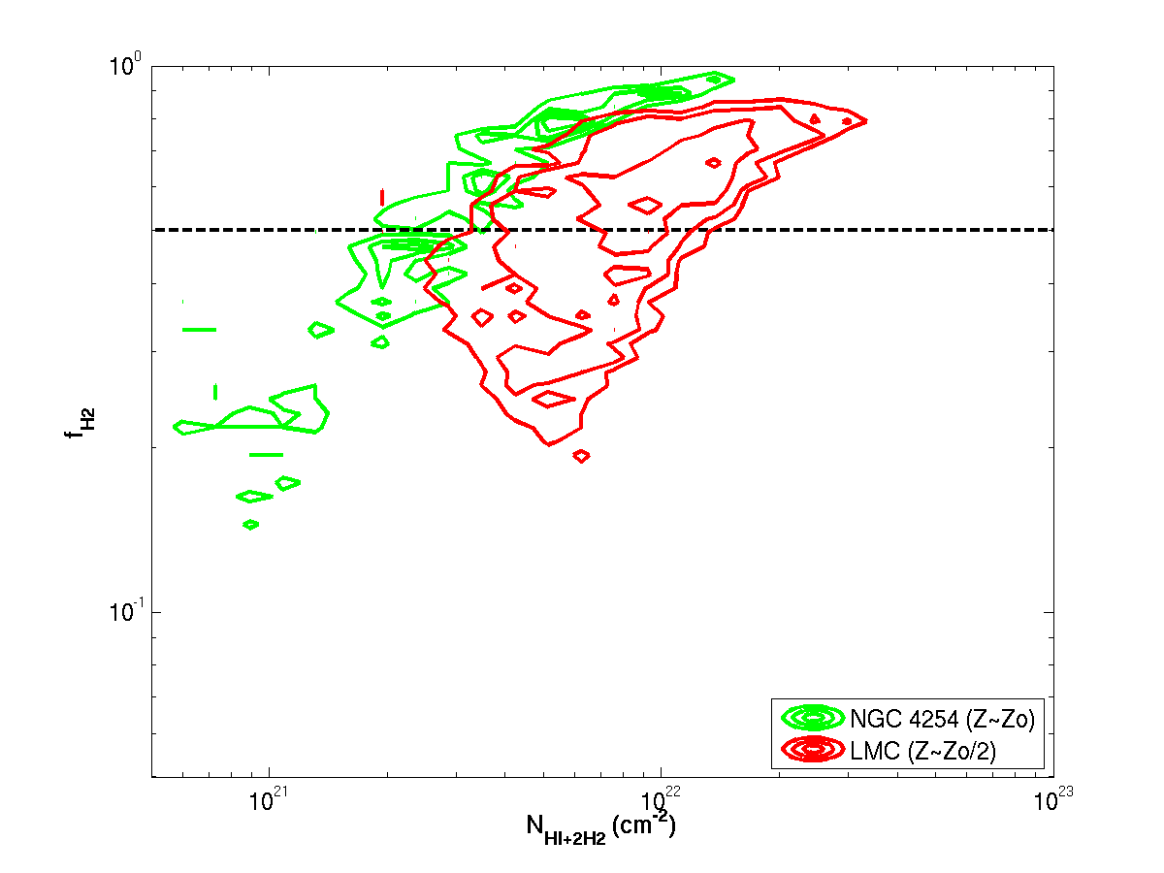
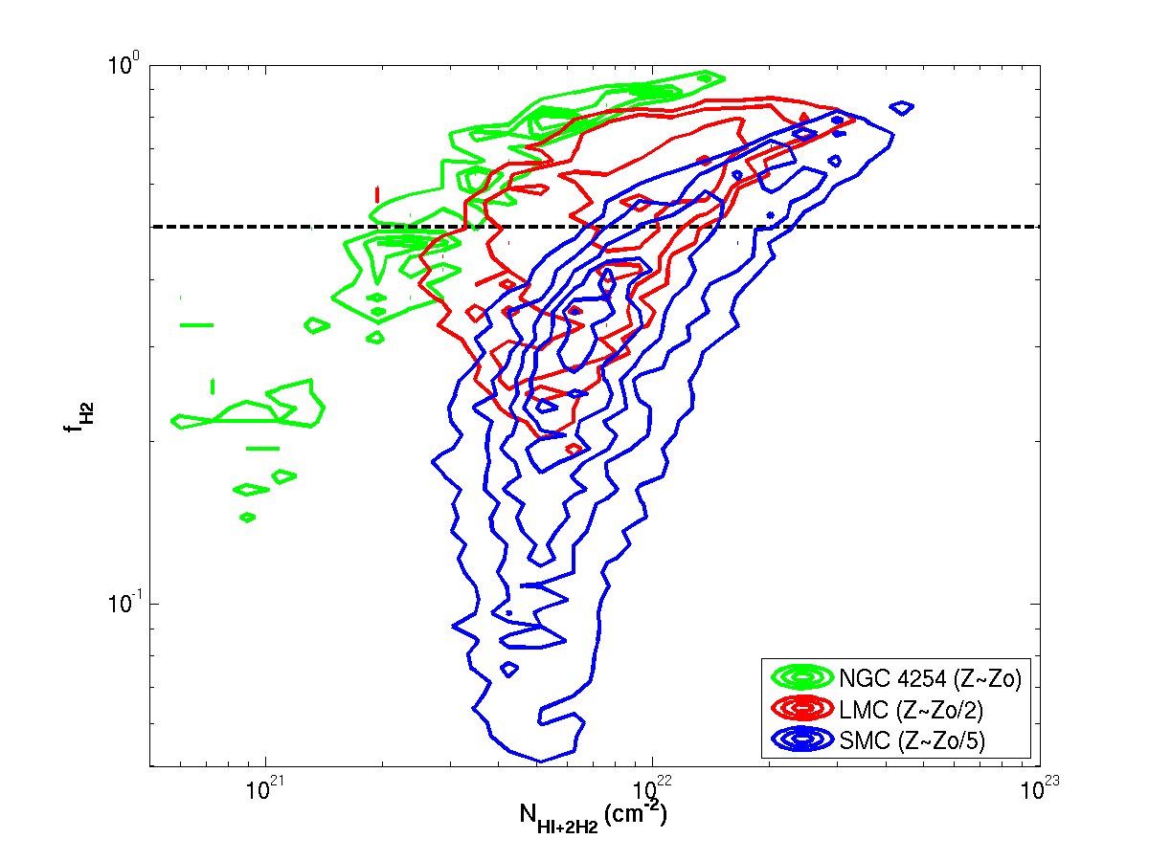
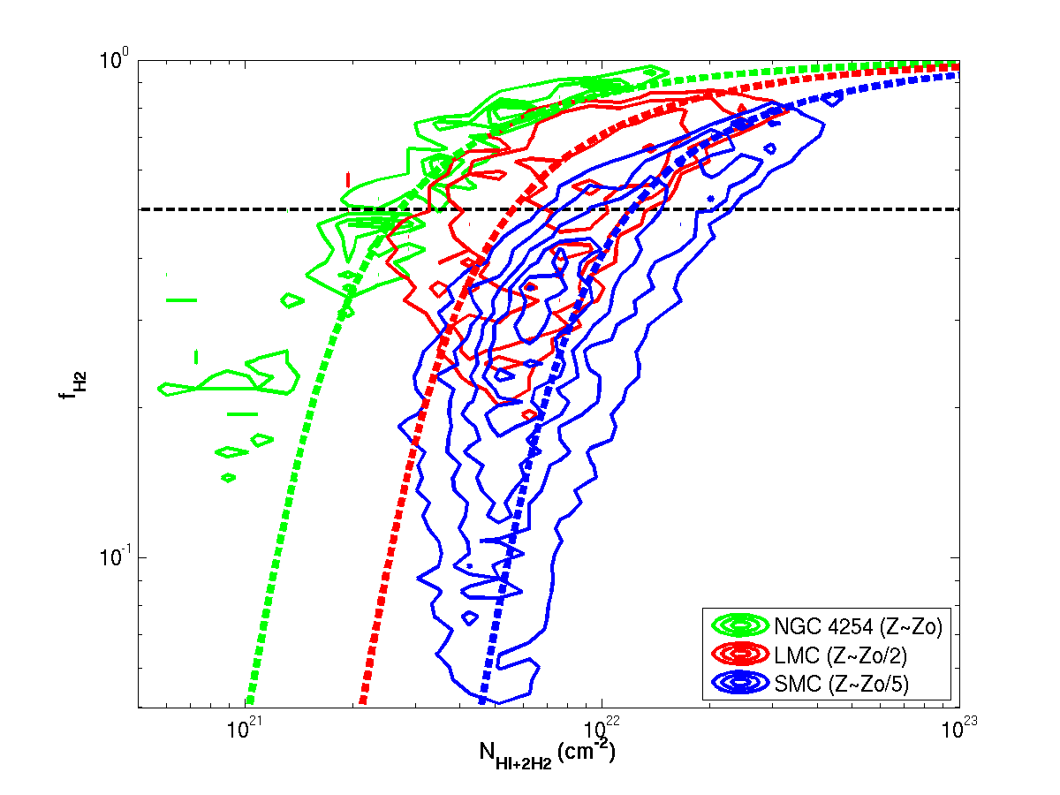
Resolved molecular fractions in galaxies
Krumholz, McKee, & Tumlinson (2009)

Slide 29
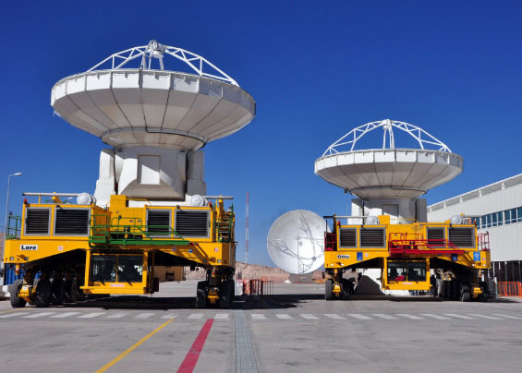
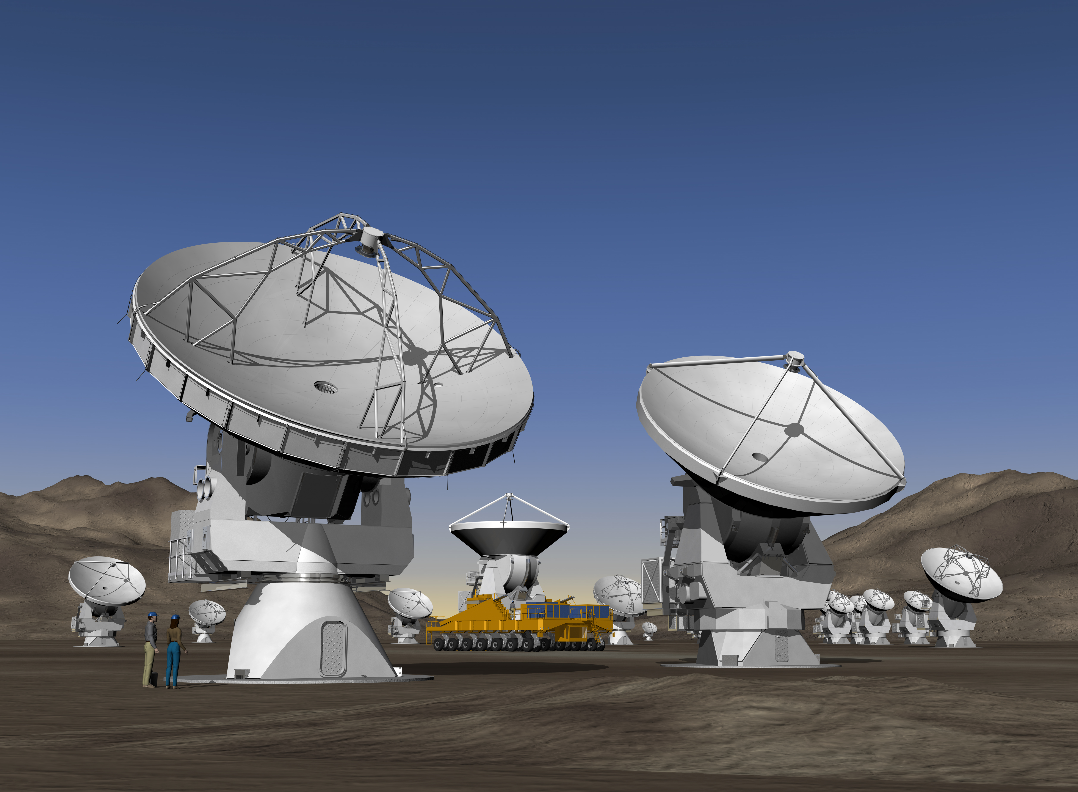

Slide 30
Structure of the molecular ISM
Larson relations beyond the Milky Way
Resolving extragalactic PDRs
Structure of neutral carbon emission?
Heating-Cooling equilibrium?
“Dark” molecular gas
Dust continuum imaging and mass-modeling
Cold dust and (maybe) very cold dust: origin of mm-wave excess?
Optically thin CO emission?
Molecules and star formation at low Z
CO at the lowest metallicities
Resolved star formation laws and molecular fractions
Fragmentation and feedback at low metallicities
Low Z at high-z?

Slide 32
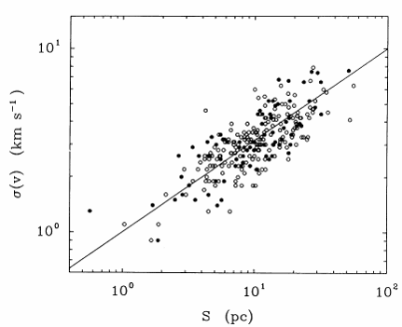
GMCs obey simple scaling relations
First recognized by Larson (1979,1981)
Attributed to Kolmogorov-like turbulence
Today we attribute it to compressible, shock-dominated supersonic (Burger’s) turbulence
σ=0.72 R_{pc}^{0.5} km/s
The coefficient is related to surface density
M~Rσ² → M/R²~const
Σ=170 Mo/pc²
Solomon et al. (1987)

Slide 33
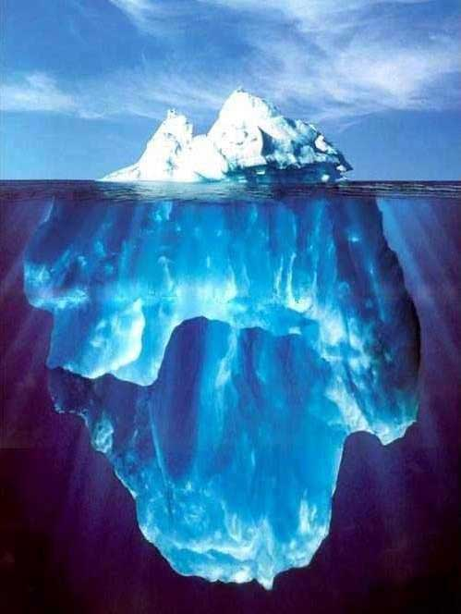
Measuring extragalactic GMC properties
The tip of the iceberg in the sea of noise…
Other galaxies are far far away…
To account for these effects the CPROPS package was developed
Bolatto et al. (2005), Rosolowsky & Leroy (2006), Blitz et al. (2007)

Slide 34
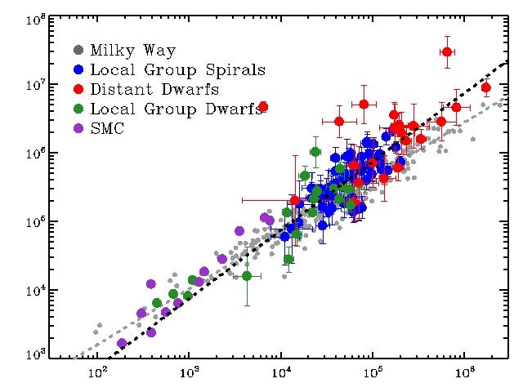
Luminosity-Virial Mass Relation
(one version of other independent Larson’s Law) We find M_{vir} ~ L_{CO} …
- Solomon (MW): M_{vir} ~ L_{CO}^{0.8}
CO-to-H2 factor roughly as MW if GMCs are virialized…
SMC falls on Galactic line.
Other scaling relations:
L_{CO} vs. R
L_{CO} vs. σ
M_{vir} vs. R
follow from these two.
Virial Mass ∝σ² R [M_{sun}]
CO Luminosity
Bolatto, Leroy, et al. (2008)
Notes:
Excellent agreement
Completely linear
Similarity has implications for Xco

Slide 35
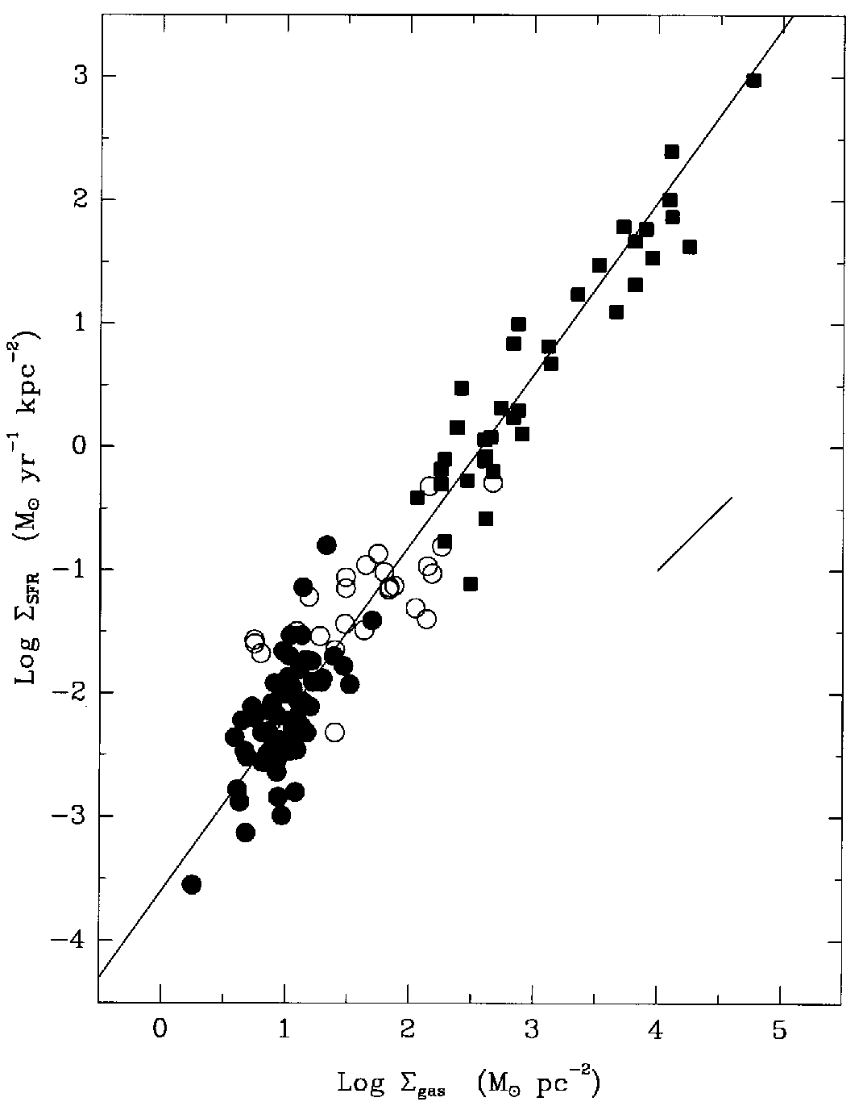
Low metallicity and the star formation laws
Low metallicity local dwarf galaxies and outer galaxy disks are some of the most discrepant objects when placed on the molecular star formation law
Is this the result of imperfect estimates of H₂ surface densities?
SMC
SMC
Kennicutt 1998
Bigiel et al. (2008)

