Slide 1
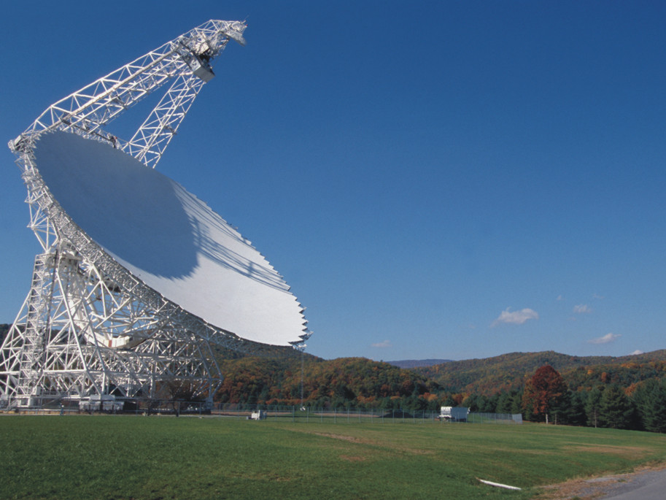
The molecular ISM of high-redshift galaxies A.I. Harris¹, A.J. Baker², A.M. Swinbank³, I. Smail³, C.E. Sharon², A.C. Edge³, S. Zonak¹ and R. Ivison⁴, L. Hainline¹, J. Richard³, P. Cox⁵, M. Krips⁵, R. Neri⁵, A. Weiss⁶, C. De Breuck⁷, R. Blundell⁸, G. Fazio⁸, M. Gurwell⁸, S. Longmore⁸, J. Younger⁸
¹University of Maryland, ²Rutgers University, ³Durham University, ⁴ROE, ⁵IRAM, ⁶MPIfR, ⁷ESO, ⁸Harvard-Smithsonian SMA
Photo credit NRAO

Slide 2
Summary
We are beginning to understand the complexity of the ISM in high redshift galaxies.
Complexity is good: single component models have little discrimination for physical conditions, and failures rule models out.
Given the overall uncertainties, extrapolating from L’_{CO(mid-J)} to L’_{CO(1−0)} for gas mass estimates is probably valid much of the time.
But there are now exceptions!
Multiple components
Warm, dense gas with low CO column densities?
The next five years will be very interesting, as observations of more lines, some with high spatial resolution, becomes possible.

