Slide 1
Multiwavelength Properties of 70 μm Selected Galaxies in the COSMOS Field
Assembly, Gas Content and
Star Formation History of Galaxies
Charlottesville, VA
2009 September 24
Jeyhan S. Kartaltepe
(IfA → NOAO), David Sanders, Emeric Le Floc’h, Dave Frayer, Herve Aussel, Nick Scoville, Mara Salvato, Peter Capak, Lin Yan, Jason Surace + the COSMOS team

Slide 2
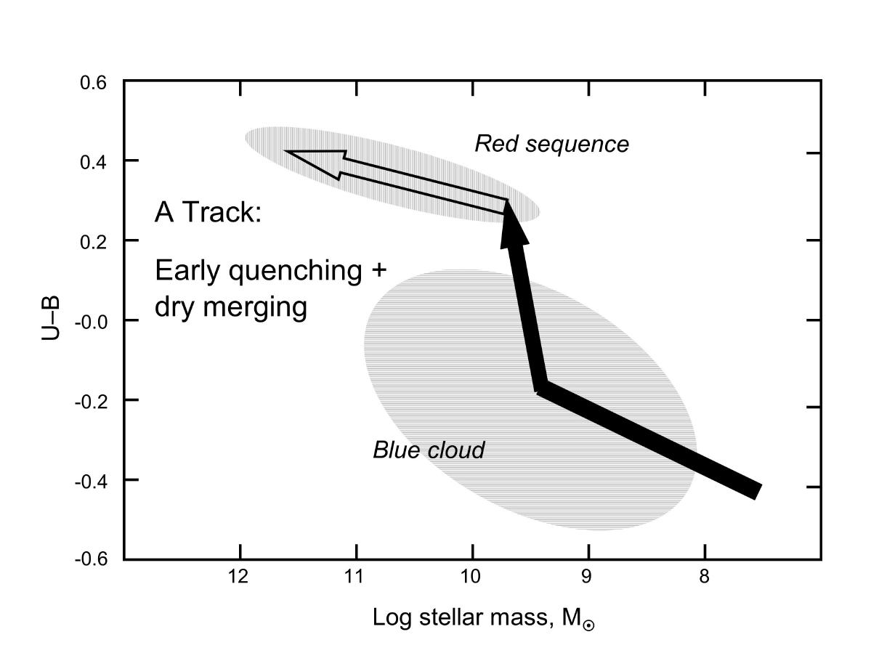
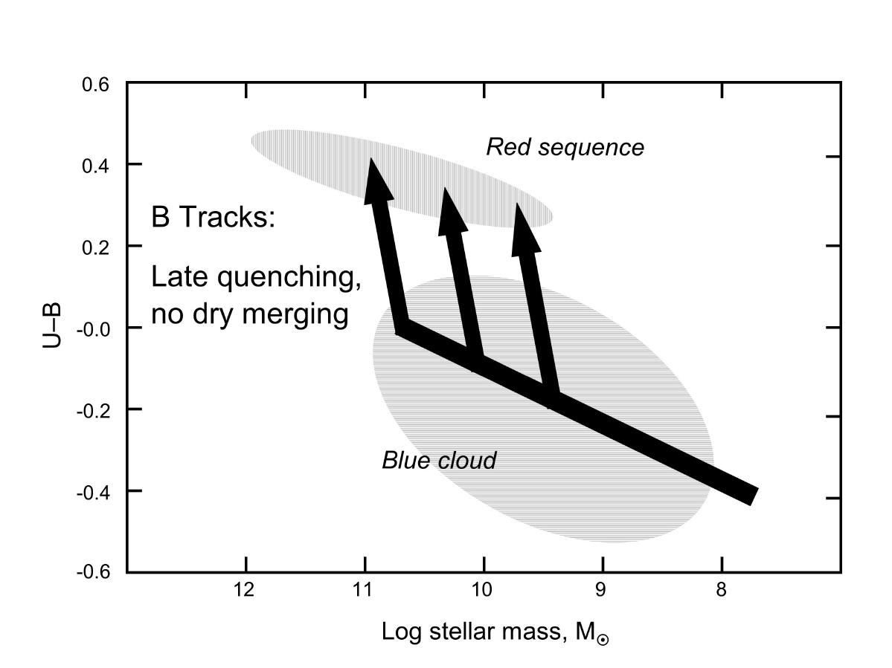
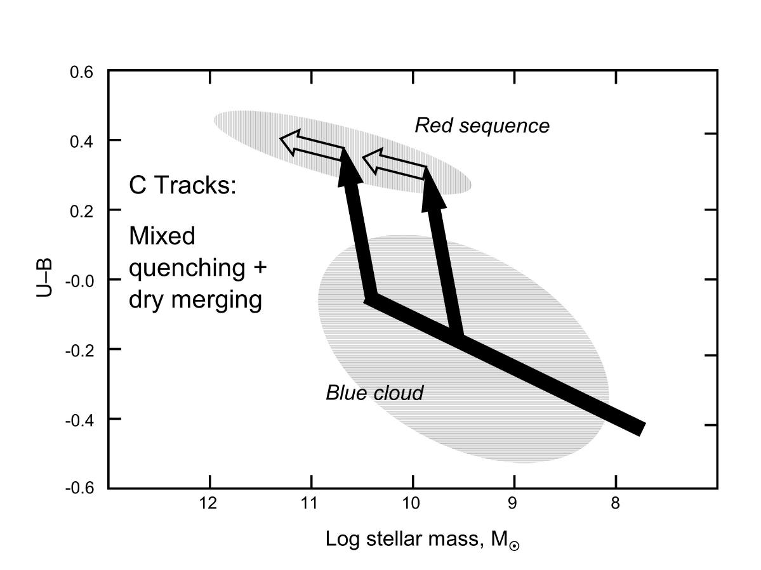
Motivation
What role do mergers play in galaxy evolution?
In forming AGN? Starbursts? Massive ellipticals?
Correlation of morphology and merger phase to
Luminosity
AGN/Starburst activity
Are there enough gas-rich mergers to form the red sequence?
Dry Mergers
Gas-rich Mergers
Mixed
Faber et al. 2007

Slide 3
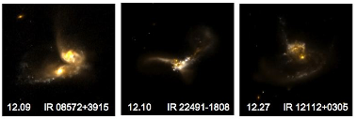
(U)LIRGs
Locally
All ULIRGs are major mergers of gas-rich spirals
LIRGs are a mix of gas-rich mergers (on the way to ULIRG phase?) and high luminosity “ordinary” spirals
Morphology/merger stage is strongly correlated with L_{IR}
Rare objects
At high redshift
Much more common
Dominate the cosmic star formation rate at z > 1
Do the same trends hold at high-z?
See Vivian U’s poster for properties (SEDs and colors) of local (U)LIRGs

Slide 4
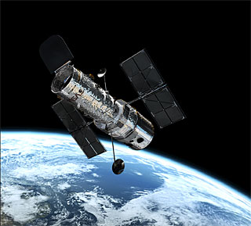
COSMOS: The Cosmic Evolution Survey
HST Treasury program to image an ~2 deg² field
Large area means you can
Reduce the effects of cosmic variance
Use large samples of galaxies
Use a large volume (equivalent to SDSS at high-z!)
Multiwavelength Coverage
Spitzer, Chandra, XMM, VLA, + 30 UV/optical/NIR bands
Accurate photozs (Ilbert et al., Salvato et al. 2009)
Ideal combination of breadth and depth

Slide 5
High Redshift (U)LIRGs
Studies at high redshift have been limited
Small samples
Uncertain luminosities
Most studies are based on Spitzer 24 μm selection
At z~1, 24 μm probes rest frame 12 μm, 8 μm by z~2
Ideally, would like to probe near or beyond the peak of IR emission
Longer wavelength data is only available for small numbers of objects (e.g., Spitzer 70/160 μm, Submillimeter)
With large field, can obtain large number of sources, even with relatively insensitive 70 μm detector

Slide 6
Our 70 μm Sample
Spitzer/MIPS 70 μm selection (Frayer et al. 2009)
Sample consists of 1505 sources matched to optical counterpart in ACS imaging
463 are also detected at 160 μm
Redshift distribution
Peaks at z ~ 0.35
High-z tail, 281 sources at 1 < z < 3
Estimating luminosity
Fit templates to IR SED (8, 24, 70, [160] μm)
Integrate from 8-1000 μm to get L_{IR}
Luminosities accurate to ~0.2 dex (0.05 dex when detected at 160 μm)

Slide 7
L_{IR}
HyLIRGs
30 out to z ~ 3
ULIRGs
307 out to z ~ 3
log (L_{IR})
LIRGs
686 out to z ~ 1.4
Redshift (z)

Slide 8
SEDs
> 13
12 - 13
All 1505 binned by L_{IR} and normalized at 1 μm
Range of shapes
Trends with L_{IR}
Increased IR contribution
Stellar bump, 5 μm dip
Power-law SEDs
ν L_{ν} [arbitrary units]
11 - 12
10 - 11
< 10
Rest-Frame Wavelength [μm]

Slide 9
AGN Signatures
X-ray detection
L_{X} > 10⁴² erg s⁻¹
132 in total
.

Slide 10
AGN Signatures
X-ray detection
L_{X} > 10⁴² erg s⁻¹
132 in total
Radio excess sources
29 in total
.
562 sources detected in the radio
q (FIR / radio flux)
log (L_{IR})

Slide 11
AGN Signatures
X-ray detection
L_{X} > 10⁴² erg s⁻¹
132 in total
Radio excess sources
29 in total
Power-law SEDs
169 in total
.
ν L_{ν} [arbitrary units]
Rest-Frame Wavelength [μm]

Slide 12
AGN Signatures
X-ray detection
L_{X} > 10⁴² erg s⁻¹
132 in total
Radio excess sources
29 in total
Power-law SEDs
169 in total
IRAC color-color selection
Stern et al. 2005
232 in total
.
([3.6] – [4.5])_{Vega}
([5.8] – [8.0])_{Vega}

Slide 13
AGN Signatures
X-ray detection
L_{X} > 10⁴² erg s⁻¹
132 in total
Radio excess sources
29 in total
Power-law SEDs
169 in total
IRAC color-color selection
Stern et al. 2005
232 in total
Obscured AGN candidates / Dust Obscured Galaxies
Fiore et al. 2008, 2009; Dey et al. 2008
60 in total (56 with R-K > 4.5)
DOGs
F(24) / F(R)
(R - K)_{Vega}

Slide 14
AGN Fraction
100% for HyLIRGs
>70% for ULIRGs
AGN Fraction
5% at low L_{IR}
log (L_{IR})
AGN Fraction increases systematically with L_{IR} (as it does locally)!

Slide 15
Morphological Classification
Spiral Elliptical QSO Unknown
Minor Merger
Major Mergers
I II III IV V

Slide 16
Merger Fraction
Fraction of spirals drops
Major mergers increase to ~50%
Unknowns make up additional ~20%
Minor mergers have an effect only at log(L_{IR}) < 11.5
Significant contribution (20%) from ‘QSO’ class at high L_{IR}
Fraction
log (L_{IR})
See Jason Surace’s poster for morphology comparison of local and distant (U)LIRGs

Slide 17
Galaxy Colors
Color Bi-modality
Contours : optically selected galaxies
Blue cloud
Red Sequence
Green Valley
Red Sequence
(U-V)₀
Green Valley
Blue Cloud
M_{K}

Slide 18
Colors
(U-V)₀ (U-V)₀ (U-V)₀ (U-V)₀ (U-V)₀
Contours: optical population
Colored points: 70 μm sources coded by L_{IR}
Colors peak in Green Valley
M_{K}
M_{K}

Slide 19
(U-V)₀
M_{K}
Single redshift bin (0.8 < z < 1.0)
Classified optical comparison sample
Chose 4 M_{K} slices (shaded)
Number
log (L_{IR})

Slide 20
Morphology and Color
Number
Number
(U-V)₀ (U-V)₀ (U-V)₀ (U-V)₀

Slide 21
Morphology and Color
70 μm Sources
Optically Selected
Blue Cloud
Red Sequence
Number
(U-V)₀

Slide 22
Summary
70 μm selection allows robust luminosity determination
SED analysis allows the identification of 355 AGN
Strong correlation of properties with luminosity
Spirals decrease from 70% to 10%
Major mergers increase from 10% to > 50%
AGN Fraction increases to 100% for HyLIRGs
70 μm sources peak in the Green Valley
Tantalizing evidence suggests RS can form purely from gas-rich mergers
IR galaxies represent important transition stage
Two papers have been submitted – keep an eye on astroph!

Slide 23
The Future
Comparison of dust temperatures/SED shapes
Relation between (U)LIRGs and submm galaxies
→ Herschel and SCUBA2
Near-infrared spectroscopy for high redshift line diagnostic studies
FMOS, FLAMINGOS2, MOSFIRE, etc.
High resolution near-infrared imaging for morphology of high redshift sources
WFC3 on Hubble or adaptive optics from the ground
What is the role of the evolving gas fraction?
ALMA

