Slide 1
Mid-IR Diagnostics of Star Formation in QUEST Sample
DongChan Kim - University of Virginia
QUEST=Quasar Ultraluminous Infrared Galaxies (ULIRGs) Evolution Study
PI: Sylvain Veilleux (U. of Maryalnd)
D. Sanders, D. Rupke, A. Stockton, R. Joseph, J. Barnes (IfA/U. of Hawaii)
J. Mazzarella, S. Lord (Caltech/IPAC)
R. Genzel, E. Sturm, D. Lutz, A. Contursi, M. Schweitzer, L. Tacconi (MPE)
H. Netzer, A. Sternberg (Tel Aviv University)
A. Baker (Rutgers University)
C. Mihos (Case Western Reserve University)

Slide 2
QUEST Goal: evolutionary connection between the ULIRGs and QSOs (ULIRGs -> QSOs, Sanders et al 1988).
This talk:
6 Mid-IR diagnostic methods to quantify contribution of star formation and AGN activities to the bolometric luminosity of the ULIRGs and PG QSOs.

Slide 3
6 Mid-IR diagnostic methods
1. EW (PAH 7.7µm)
2. [Ne V] / [Ne II]
3. [O IV] / [Ne II]
4. f₃₀/f₁₅ ratio
5. Modified Laurent et al. method
6. L(MIR)/L(FIR)
Sample: SPITZER IRS spectra of
74 ULIRGs and 34 PG QSOs.

Slide 4
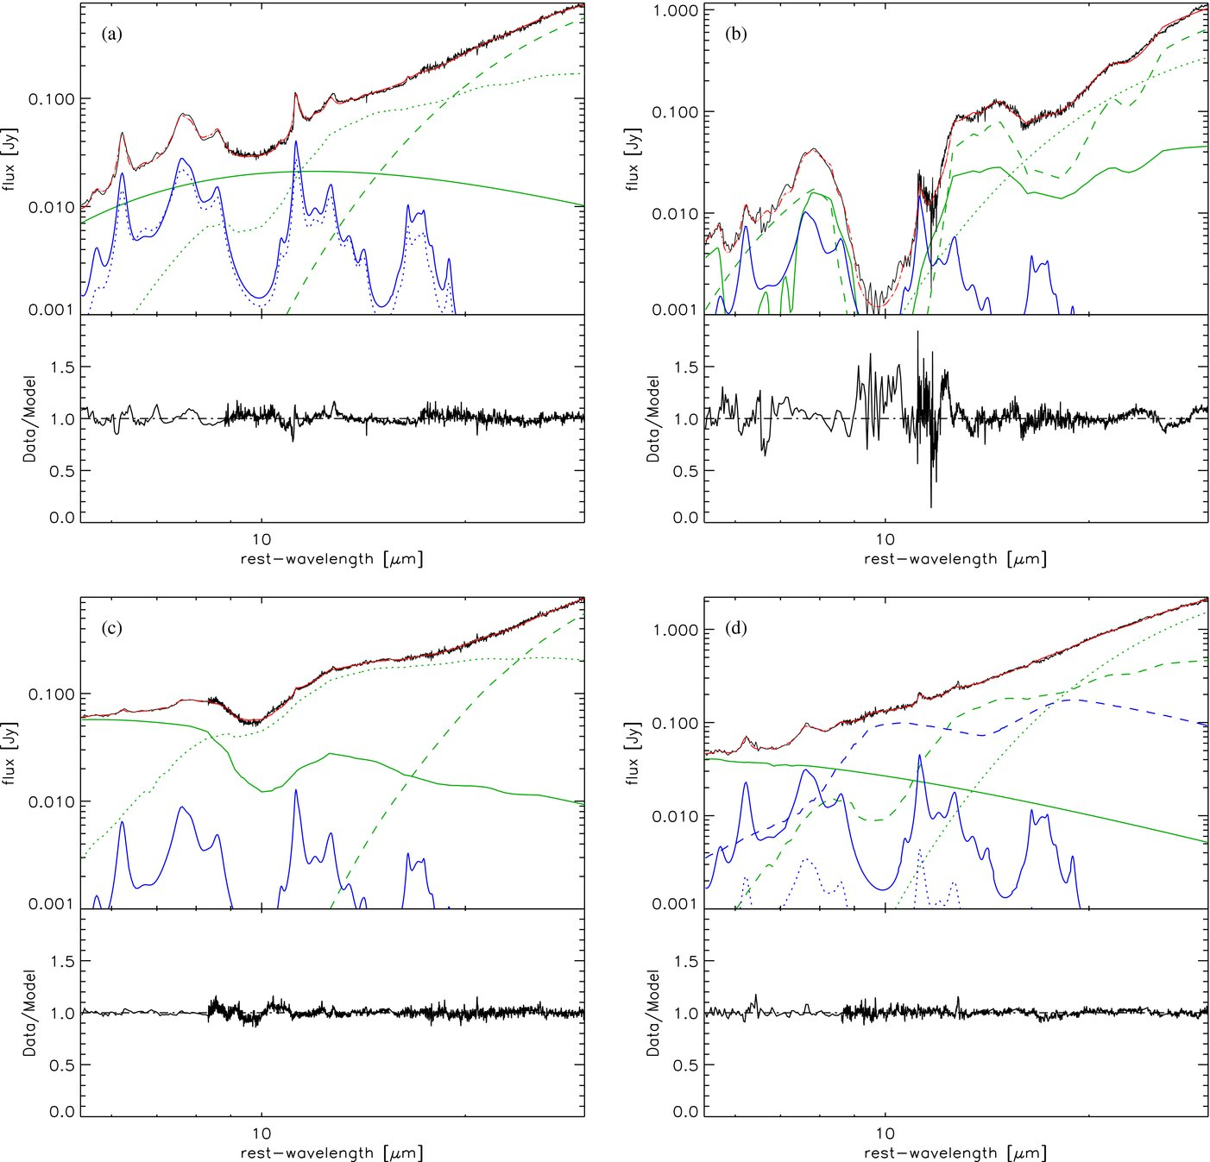
#1. EW (PAH 7.7 um) (Genzel et al. 1998, Lutz et al. 1999)
Sample spectral decomposition

Slide 5
Distribution of EW (PAH 7.7µm)
Pure star-burst zero point:
average value of the most starburst-like ULIRGs in our sample
EW (PAH 7.7um)] = 5.5
Pure AGN zero point:
EW (PAH 7.7um) = 0

Slide 6
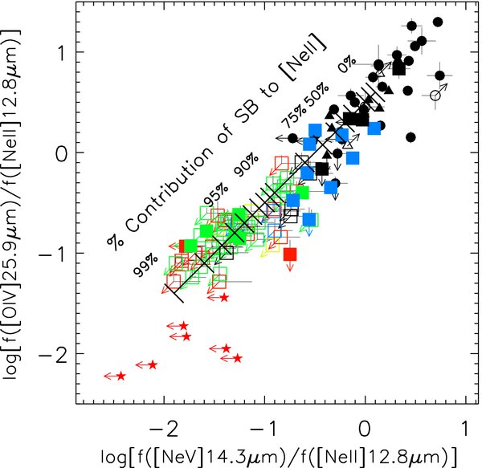
#2 & #3. [Ne V] / [Ne II] & [O IV] / [Ne II]
[Ne V] 14.3um (χ ∼ 97 eV)
→ Good indicator of AGN activity.
[O IV] 25.9um (χ ∼ 55 eV)
(Lutz et al. 1998; Smith et al. 2004; Abel & Satyapal 2008)
Pure AGN zero point:
average value of the
FIR-undetected (unobscured)
PG QSOs in our sample
log([Ne V]/[Ne II]) = 0.1
log([O IV]/[Ne II]) = 0.6
squares: LUIRGs – HII, L, Sy2, Sy1
circles: PG QSOs
stars: ISO starburst galaxies

Slide 7
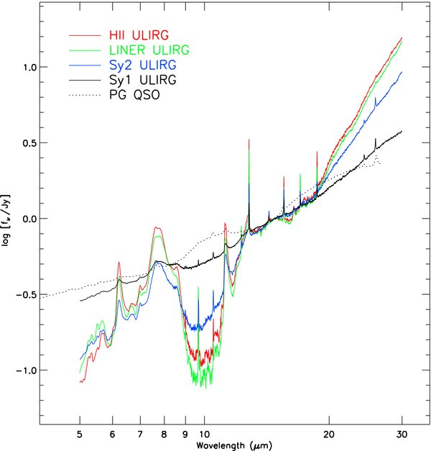
#4. f₃₀/f₁₅ continuum ratio
Pure starburst zero point
log (f₃₀/f₁₅) = 1.35
Pure AGN zero point
log (f₃₀/f₁₅) = 0.0

Slide 8
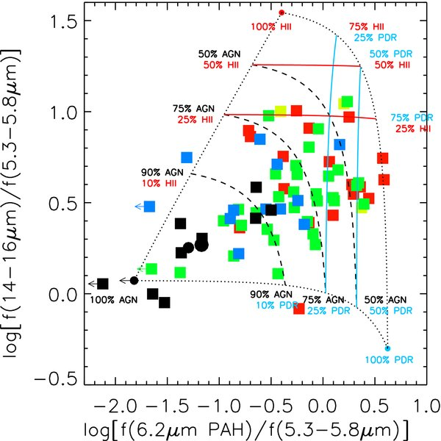
#5. f(6.2um PAH)/f(5.3-5.8um) vs. f(14-16um)/f(5.3-5.8um) (Laurent et al. 2000, Armus et al. 2007)
Pure starburst zero point:
from Armus et al. (2007)
Pure AGN zero point:
average value of the
FIR-undetected PG QSOs.

Slide 9
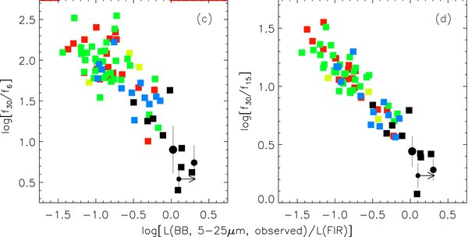
#6. L(MIR) / L(FIR)
Pure starburst zero point:
log[L(MIR)/L(FIR)] = -1.25
Pure AGN zero point
log[L(MIR)/L(FIR)] = 0.35

Slide 10
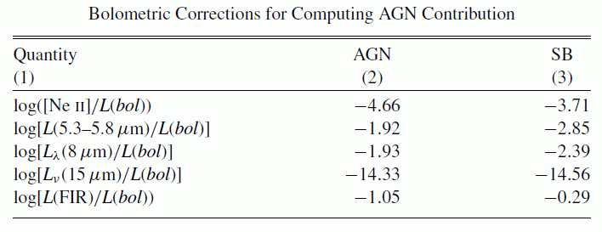
Bolometric corrections
Calculated AGN and starburst fractions from 6 methods do not refer to the bolometric luminosity.
Ex:
AGN percentage from [Ne V]/[Ne II] refers to AGN fractional contributions to the [Ne II] luminosity, and
Starburst percentage from EW (PAH 7.7um) refers to starburst fractional contribution to the continuum luminosity ~7.7um.

Slide 11
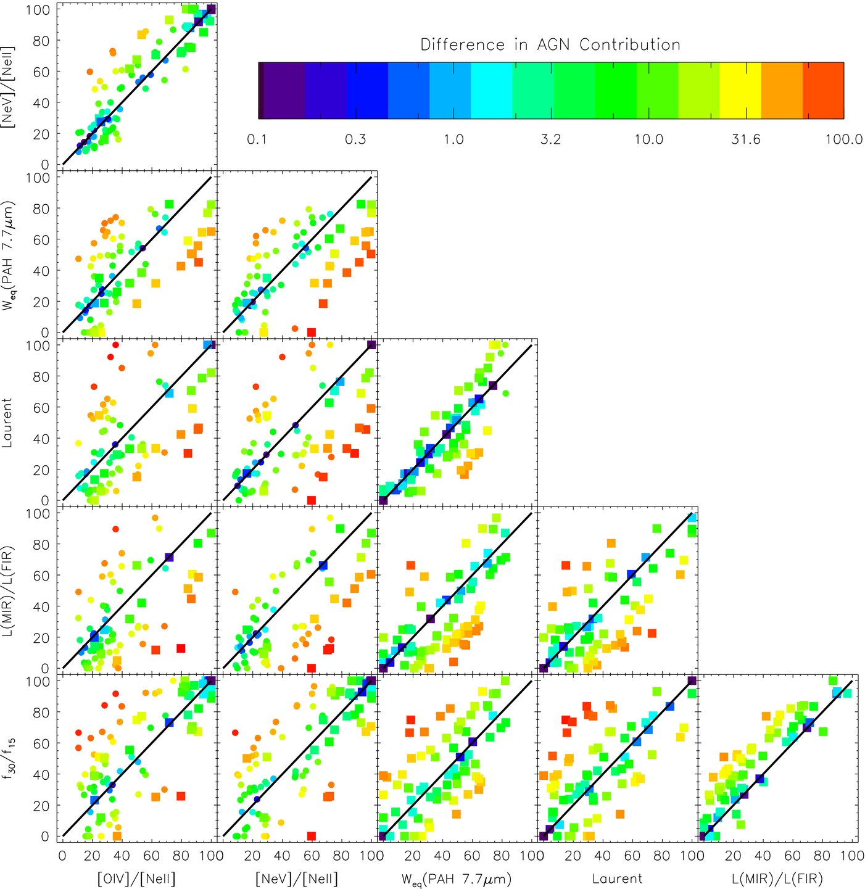
Comparison of AGN fractional contributions
6 independent methods give consistent results within +/- 15%.

Slide 12
Distribution of starburst contributions to the bolometric luminosity.
Averaged results of 6 methods:
ULIRGs: 61.2+/-21.1%
PG QSOs: 5.6+/-6.5%

Slide 13
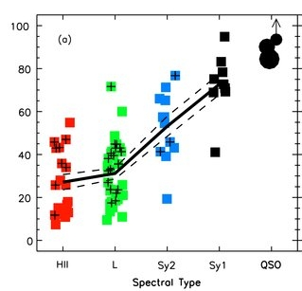
AGN fractional contributions to the bolometric luminosities
ULIRGs:
H II: 27+/-15%
LINER: 31+/-15%
Sey 2: 53+/-16%
Sey 1: 73+/-14%
PG QSOs
FIR-bright (L_{60um}/L_{15um}>1): 83+/-6%
FIR-faint (L_{60um}/L_{15um}<1): 90+/-6%
FIR-undetected: 94+/-5%

Slide 14
Residual fractions
HII and LINER ULIRGs – more disturbed
Sey 2, Sey 1, PG QSOs – less disturbed

Slide 15
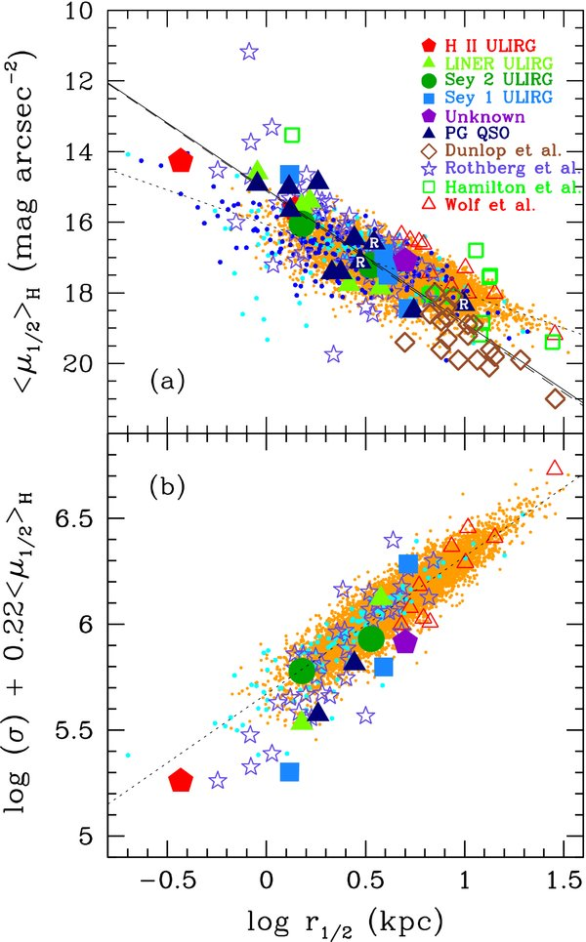
Fundamental-plane relation & blackhole mass
ULIRGs and PG QSOs are indistinguishable.
Blackhole mass (Marconi & Hunt 2003)
log(M_BH/10⁷M⊙):
ULIRGs=42.9+/-96.8
PG QSOs=43.8+/-48.6

Slide 16
Summary
1. 6 independent MIR diagnostic methods give consistent results within +/-15%.
2. AGN contributions in ULIRGs: ~30% (HII, L), 55% (Sey2), 75% (Sey2) .
3. AGN contributions in PG QSOs: ~85% (FIR-bright), 90% (FIR-faint), 95% (FIR-undetected).
4. Spectroscopic and morphological studies of the ULIRGs and PG QSOs suggest evolutionary connection (ULIRGs to QSOs).

