Slide 1
CARMA-Nobeyama 45m telescope CO Survey of Nearby Galaxies
High-resolution image
CARMA
Jin Koda (Caltech -> Stony Brook Univ.)
Nobeyama 45m telescope
Total power

Slide 2
Collaborators
Masayuki Fukuhara (U. Tokyo)
Rieko Momose (U. Tokyo)
Fumi Egusa (Caltech)
Misty La Vigne (U. Maryland ->McKendree U.)
Tsuyoshi Sawada (Joint ALMA Office)
Guilin Liu (UMASS)
Jennifer Donovan (Columbia -> Stony Brook)
Nick Scoville (Caltech)
Nario Kuno (Nobeyama Radio Observatory)
Rob Kennicutt (Cambridge)
Daniela Calzetti (UMASS)
CARMA integration team & Herschel KINGFISH collaboration

Slide 3
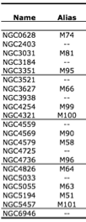
CARMA & Nobeyama CO Survey of Nearby Galaxies
On-going survey/Work in progress
21 Spiral Galaxies
All from the Spitzer SINGS survey
Full range of ancillary data
Herschel KINGFISH project (PI: Kennicutt)
Wide Range of Dynamical environments
Strong/Weak spiral galaxies
Strong/Weak/Non barred galaxies
Flocculent galaxies

Slide 4
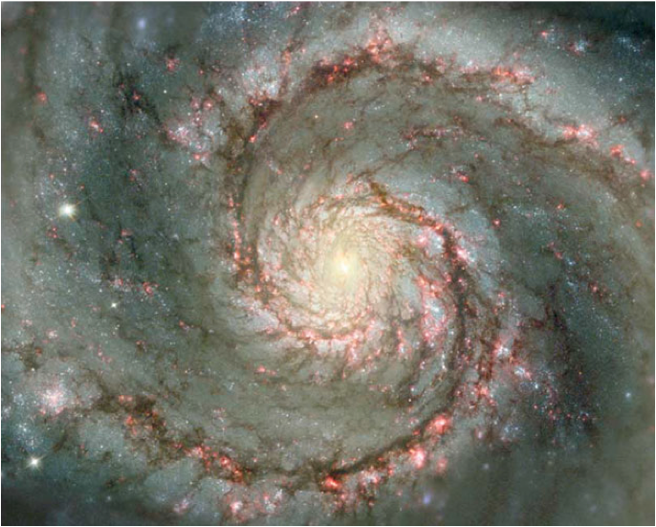
How GMCs evolve in Galactic Disks?
Hydrodynamic simulations/Hydrodynamic instabilities
Stellar spiral potential
No gravity
No magnetic field
M51 (Scoville et al. 2001)
Wada & Koda 2004

Slide 5
CARMA & Nobeyama Obs. Of M51
Best image-fidelity ever achieved with millimeter interferometers.
Total power
Total power
Zero-baselines
High-resolution image

Slide 6
CO map
Resolution
~2-4”
~100-200pc at 10Mpc
Typical separation of GMCs in MW ~100-1000pc
Sensitivity
~40 mJy
4sigma ~ 4x10⁵Msun
Two improvements
Detecting typical GMCs in nearby galaxies
High-contrast imaging interarm structures
Koda et al. 2009

Slide 7
8 micron(PAH)
Spitzer SINGS survey
Calzetti et al. 2005

Slide 8
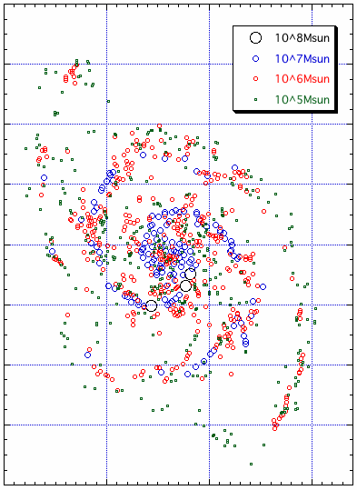
GMC & GMA Distribution
Giant Molecular Associations (GMAs)
10⁷⁻⁸ Msun
Only on spiral arms
Giant Molecular Clouds (GMCs)
10⁵⁻⁶ Msun
Both in arm and inter-arm regions
GMAs are assembled on spiral arms, and broken up through spiral arms.
Koda et al. 2009

Slide 9
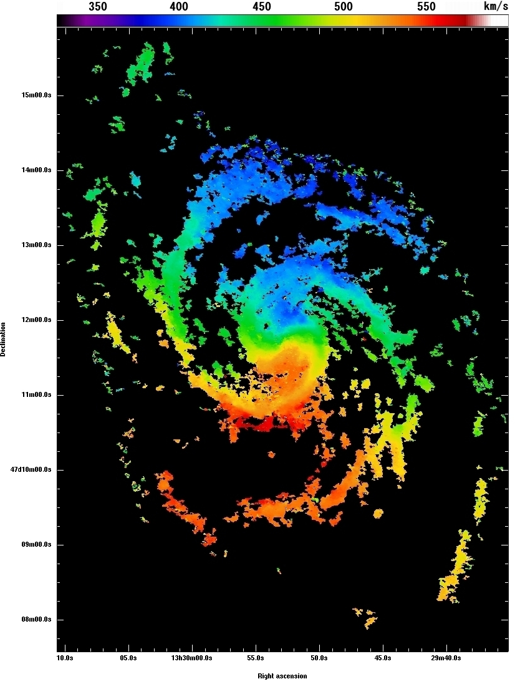
GMA Destruction due to Spiral Shears
T_{free-fall}~ 5-10 Myr
Surface densities of GMAs ~200-1000 Msun/pc2
Assuming the thickness of 100pc
T_{shear}~5-10 Myr
Velocity gradient across spiral arms: dv/dr > 200km/s/kpc
T_{shear} = 1/A_{oort}
Velocity field
Koda et al. 2009

Slide 10
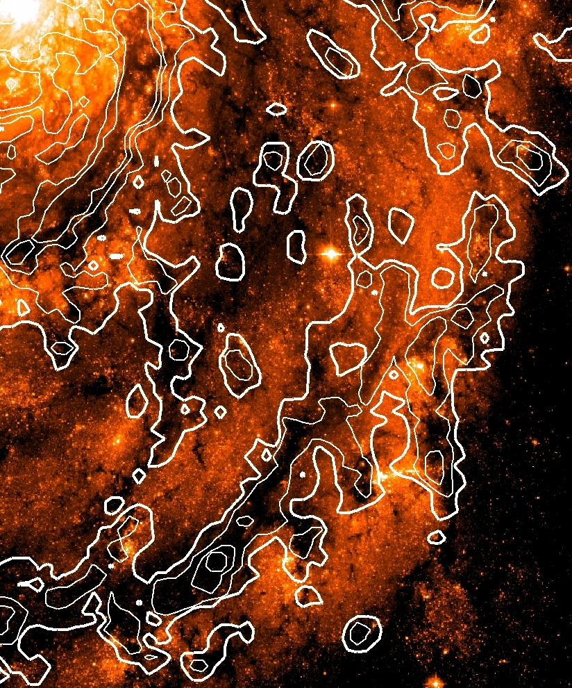
Dynamically-Driven Gas Evolution
HST image and CO contours
Remnants of GMAs (Spurs)
~10⁷Msun
High image fidelity
Unbound
Velocity gradients
Koda et al. 2009

Slide 11
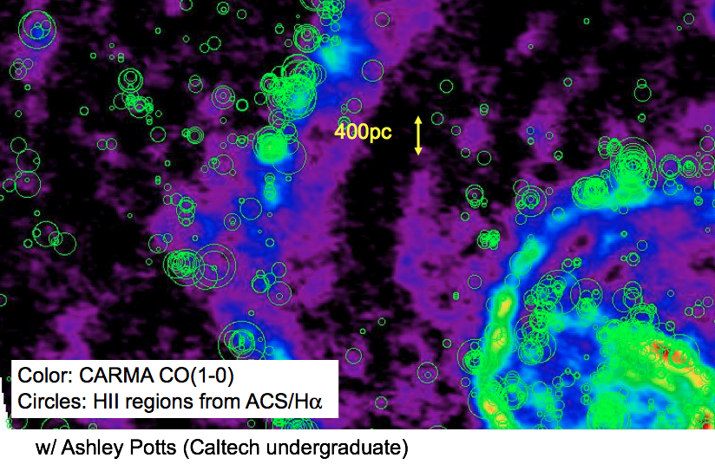
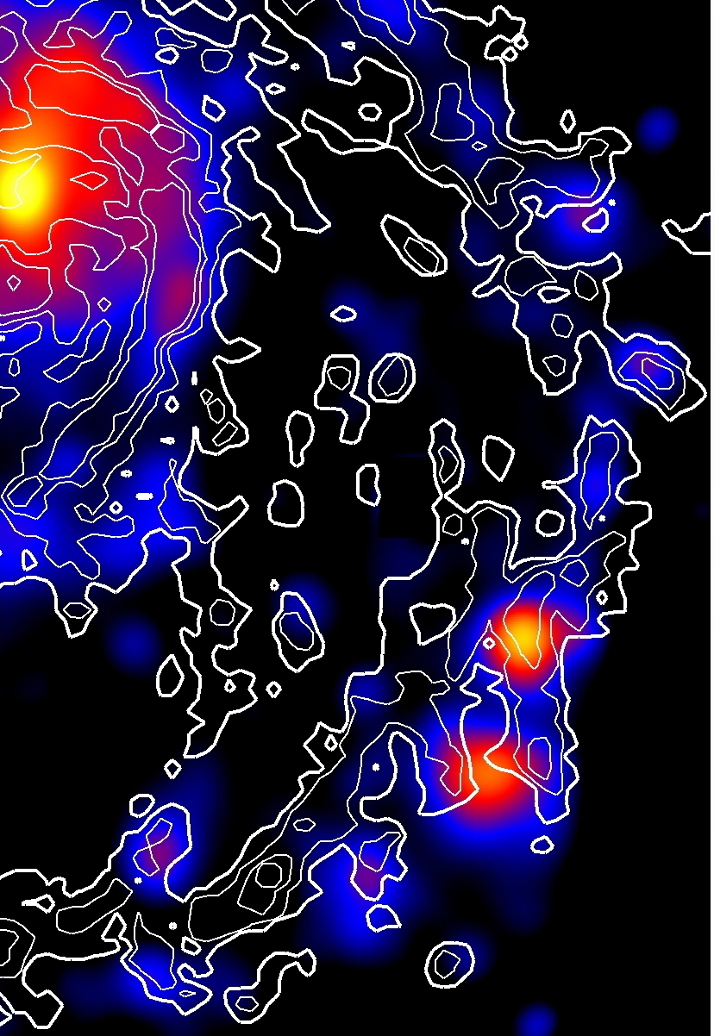
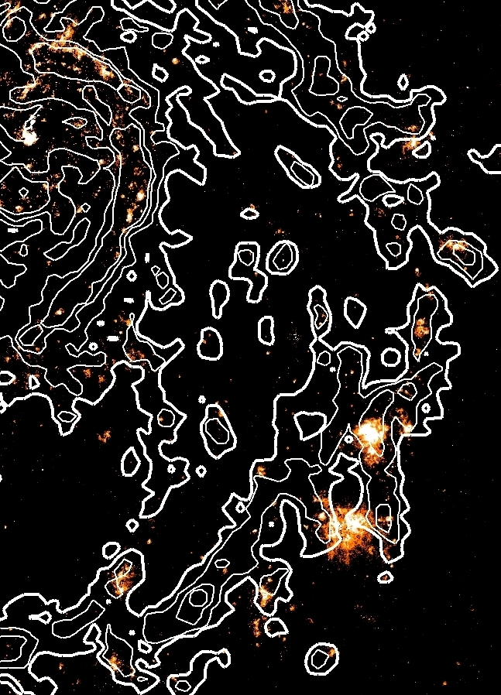
GMCs with Little/No Star Formation
Color: Star Formation Rates
Left: Ha + 24micron
(Calzetti+ 2007; Kennicutt+ 2007)
Right: HST/ACS Halpha
Beyond the Kennicut-Schmidt Law
Resolving SF regions and GMC distributions
1kpc
Contours: CO

Slide 12
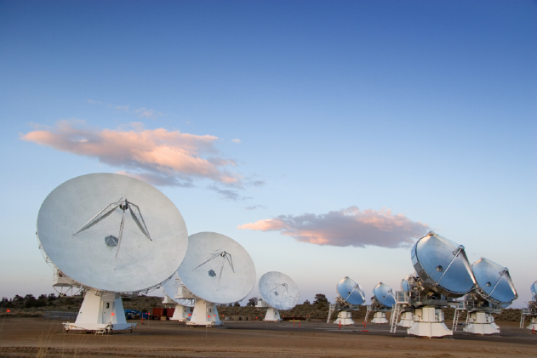
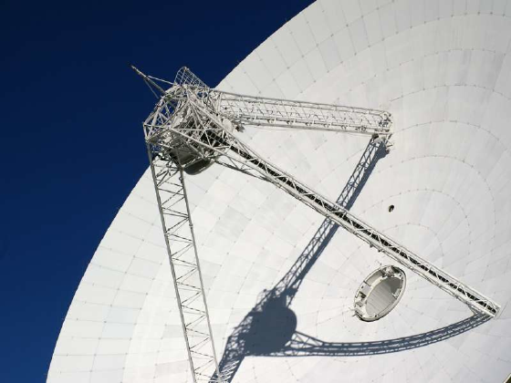
21 Galaxies with CARMA & NRO45
Range of dynamical environments
CARMA obs.
Central 2.3’ regions (19-pointings) ~7kpc at 10Mpc
4 tracks per galaxy (2 C & 2 D-config.)
Nobeyama 45m telescope
BEARS 25 beam receiver
On-the-fly mapping (Sawada+2008)
~20h per galaxy
Comparisons with BIMA-SONG
Similar area coverage
A few times higher resolution and sensitivity
CARMA
Nobeyama 45m telescope

Slide 13
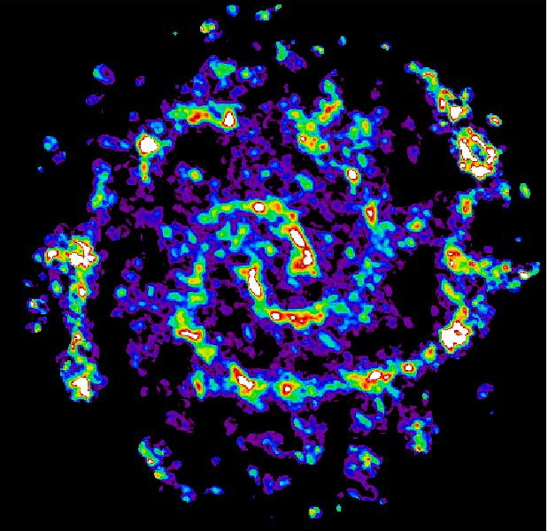
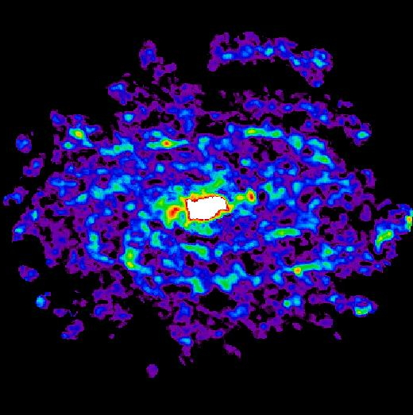
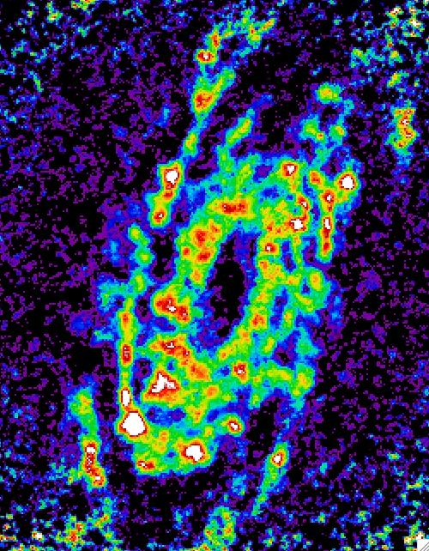
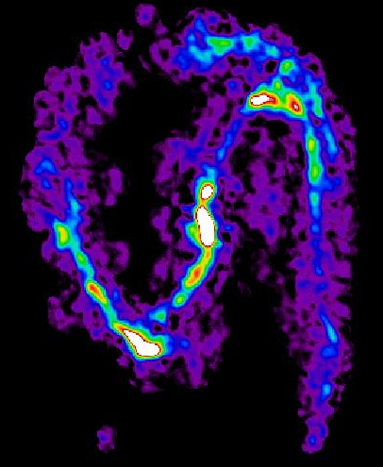
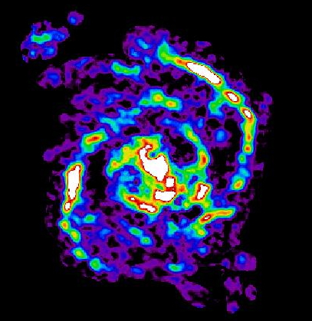
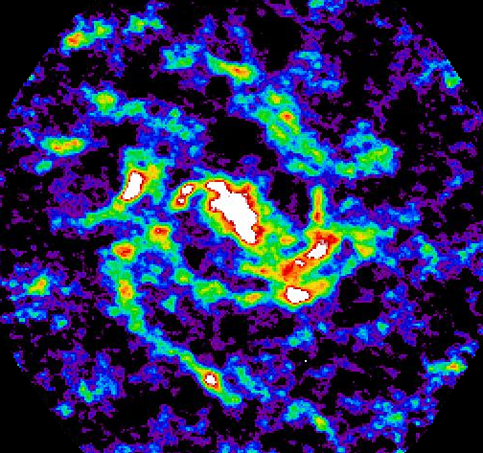
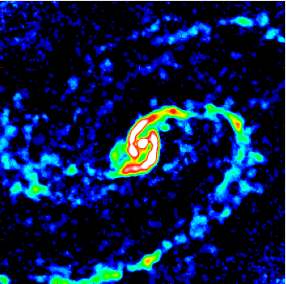
Status and Examples
CARMA: 12 targets observed (or in observing queue)
Nobeyama 45m telescope: 11 targets observed
NGC 628
NGC 5055
NGC 3521
NGC 3627
NGC 4736
NGC 4254
NGC 6946
NGC 4321
by Misty La Vigne; Fumi Egusa; Rieko Momose; Masahiro Fukuhara; Guilin Liu; Jin Koda

Slide 14
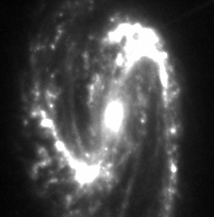
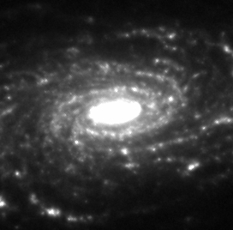
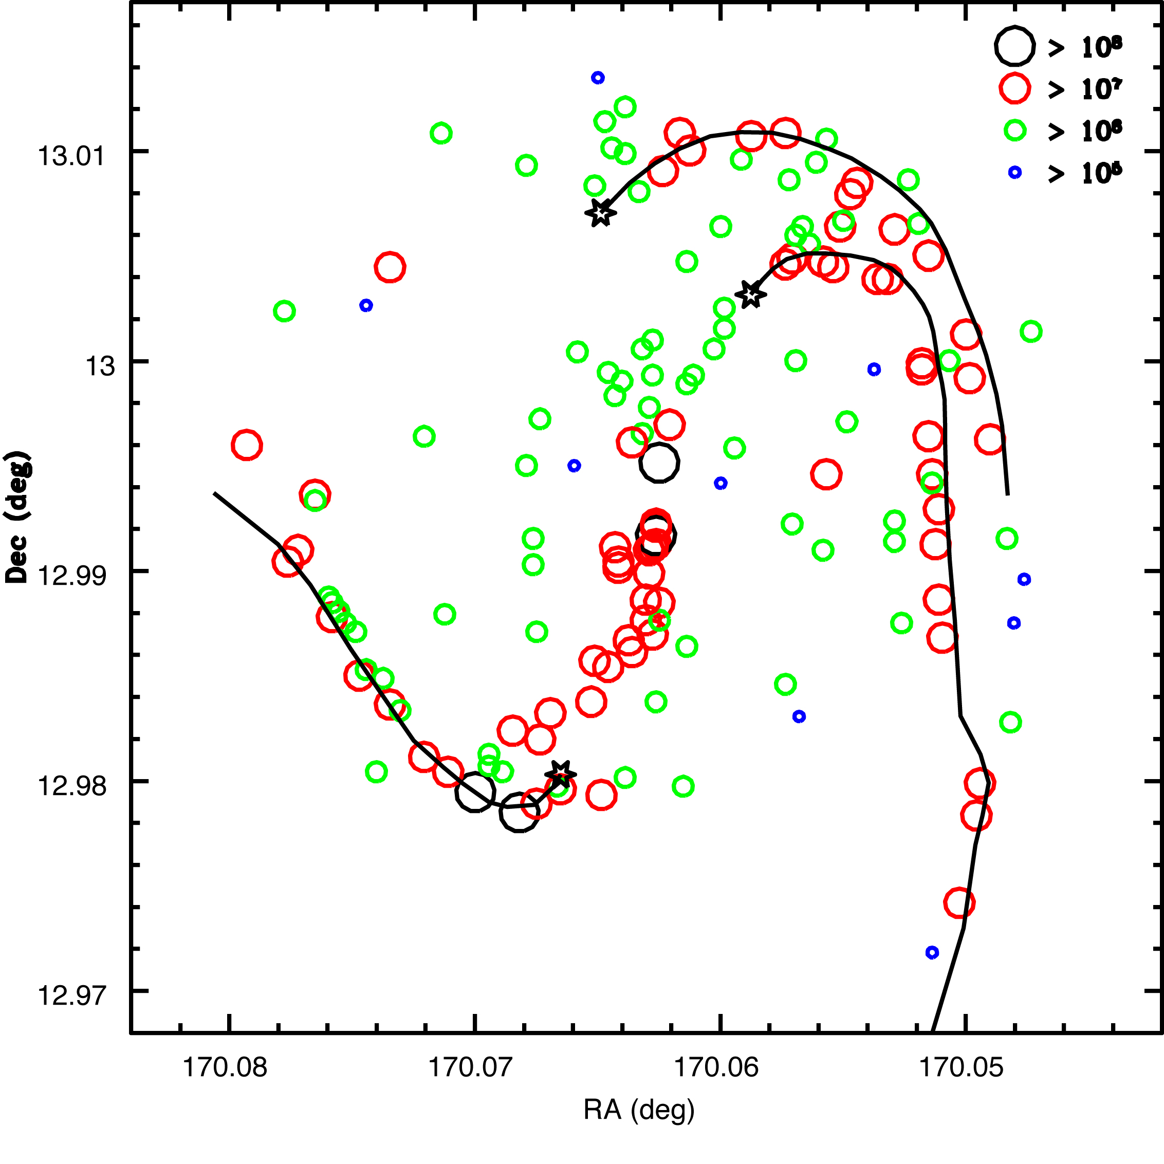
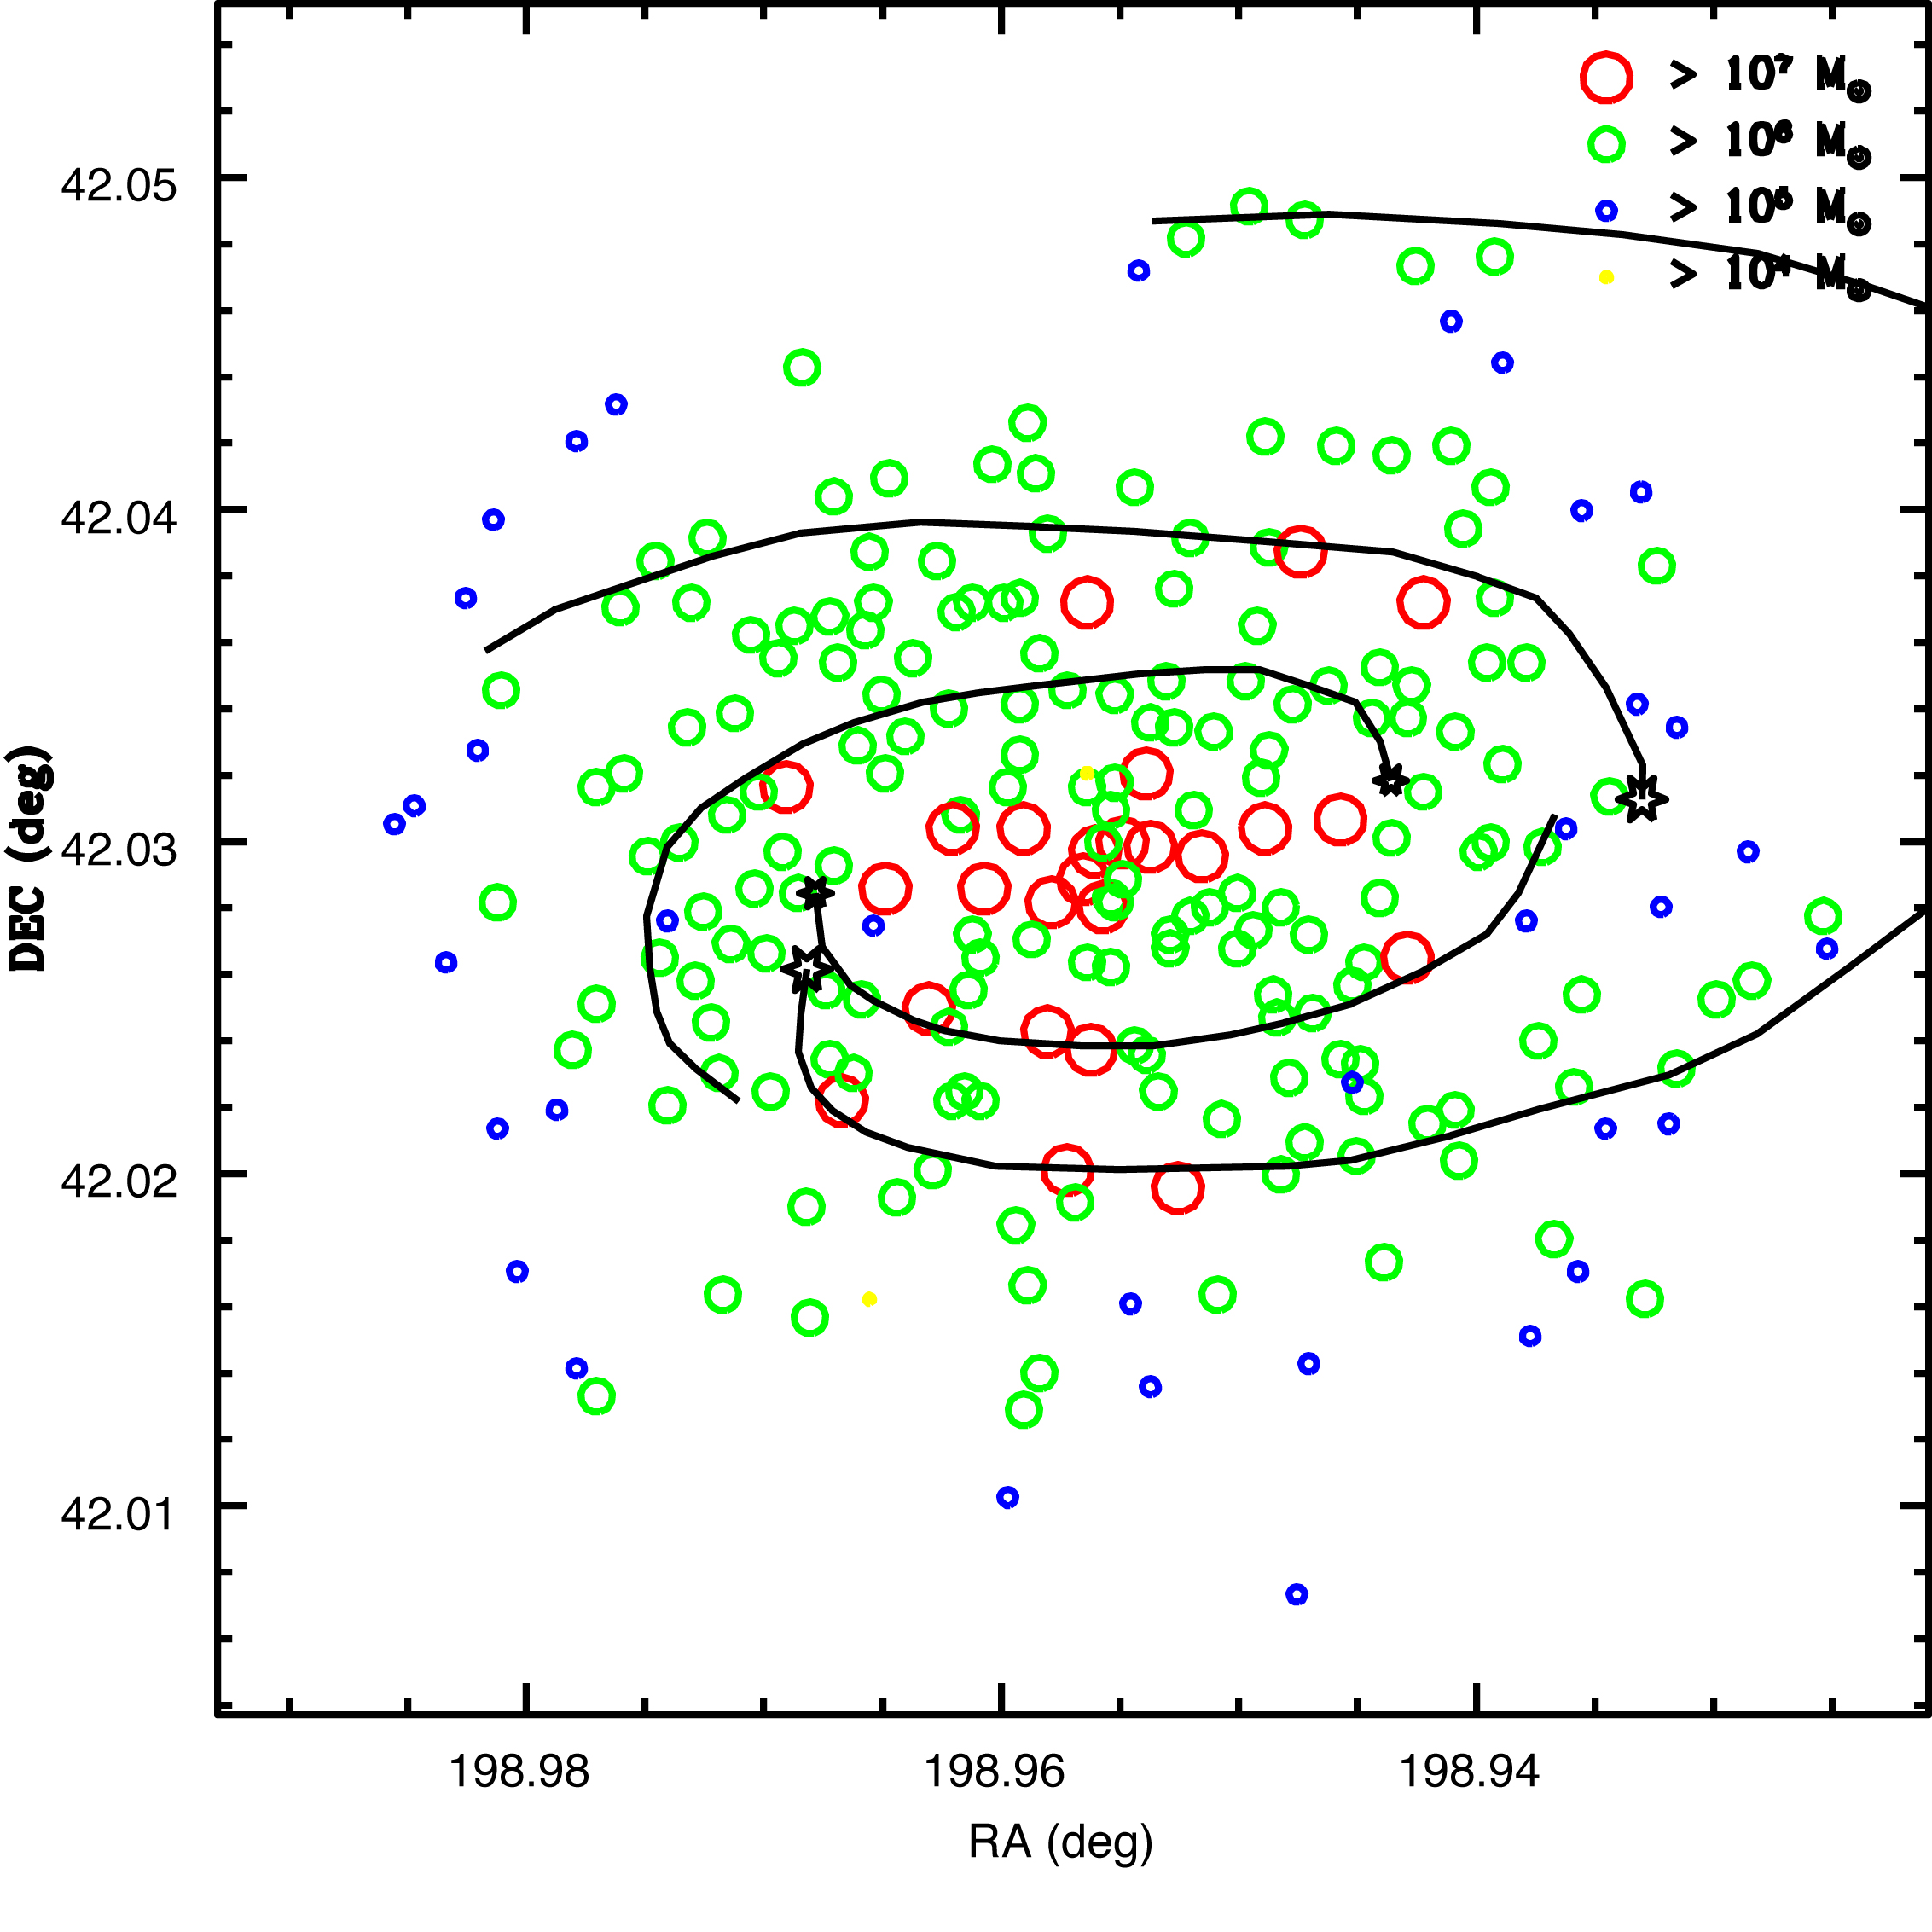
GMA Coagulation on Galactic Structures
Strong Bar
NGC 3627
Flocculent
NGC 5055
D=8.9Mpc
D=8.2Mpc
La Vigne 2009 (PhD. Thesis)

Slide 15
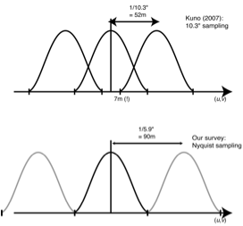
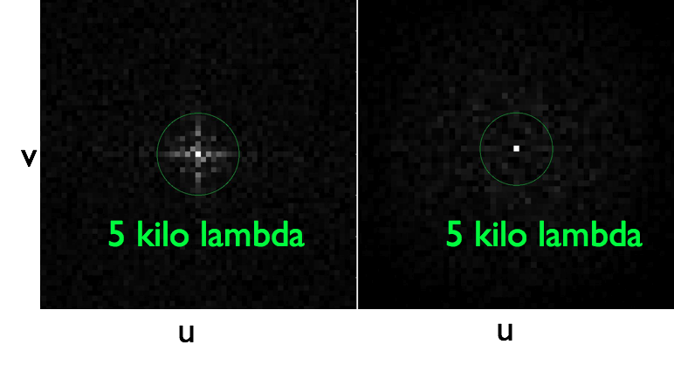
Critical developments
CARMA
New receivers
~x2 higher sensitivity
Nobeyama 45m telescope
OTF & 25beam Rx (sawada et al 2008)
Over-sampling effciently
FWHM ~15”
6” grid necessary
No aliasing effect
Reduced correlated noise
Little systematic noise
Fourier transformation of noise
ON-OFF obs.
OTF obs.

Slide 16
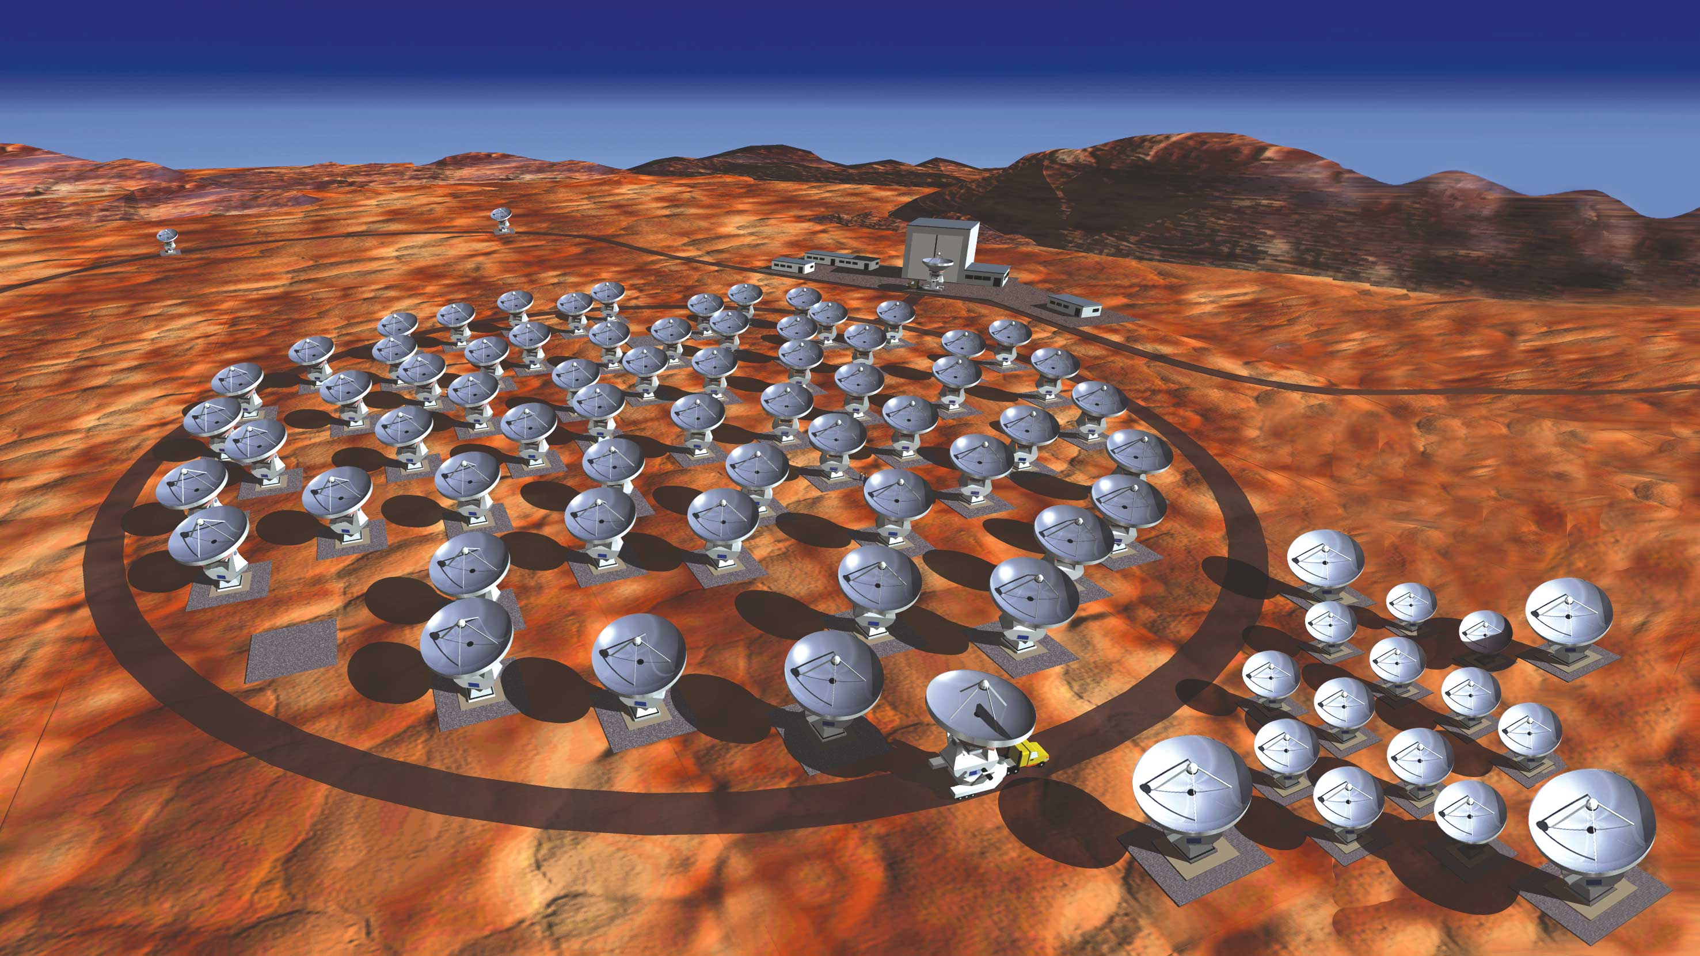
Summary
Dynamically-driven evolution of molecular gas
CARMA & Nobeyama CO survey of nearby galaxies
Direct pathway to ALMA
High resolution
High sensitivity
High image fidelity
Compact Array

Slide 17
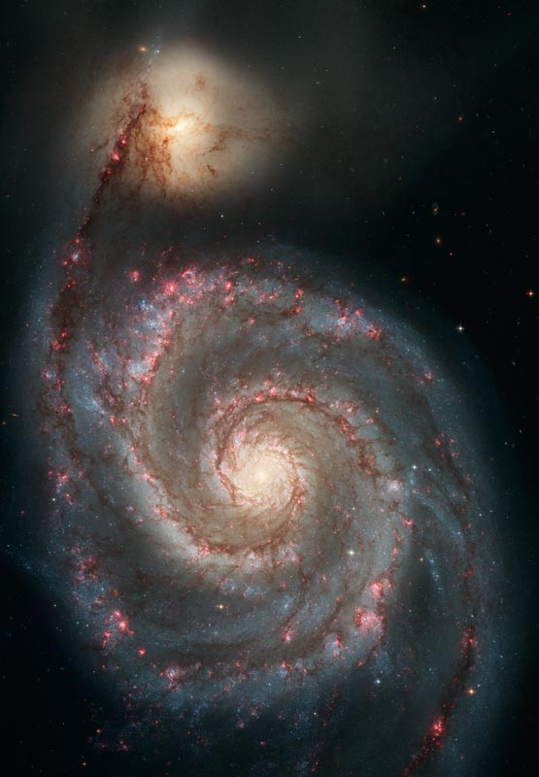
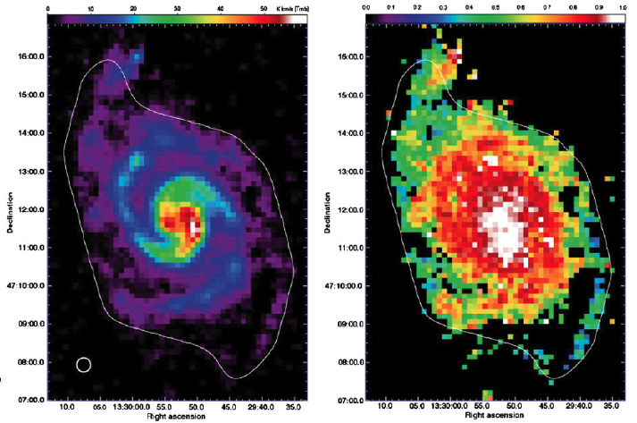
How GMCs evolve in Galactic Rotation?
Molecular gas fraction = 2*N_{H2}/(2*N_{H2}+N_{HI})
High molecular gas fraction (>70%)
Very little azimuthal change

