Slide 1
Full SED Analysis of Intracluster Light in the Virgo cluster
Jessica Krick
Eric Murphy, Vandana Desai, Carrie Bridge
Chris Mihos, Craig Rudick, James Neill, Jason Surace, Jeffrey Kenney, Jacqueline van Gorkom, Ray Carlberg

Slide 2
The Point
Galaxy evolution proceeds through gravitational and gas dynamical effects. The intracluster light (ICL) is a fossil record of these effects.
Did the IC stars form in galaxies and then get stripped, or did they form in situ?
If galaxies, then which type? And what process is responsible for the stripping?
What are ramifications for models of ICM enrichment, galaxy interactions, and structure formation?

Slide 3
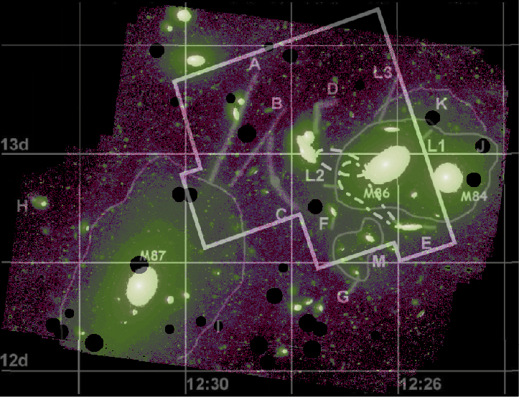
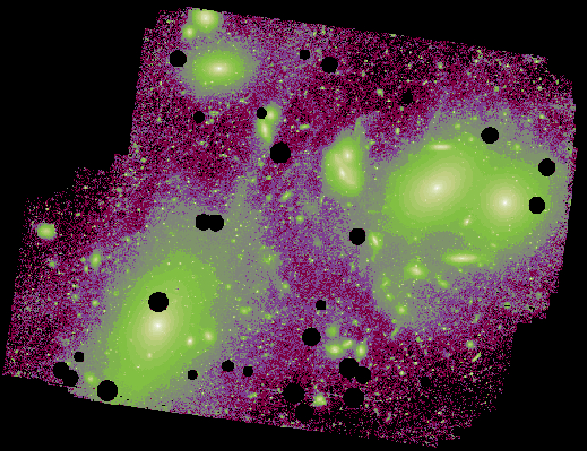
Virgo
Mihos et al. 2005

Slide 4
Virgo

Slide 5
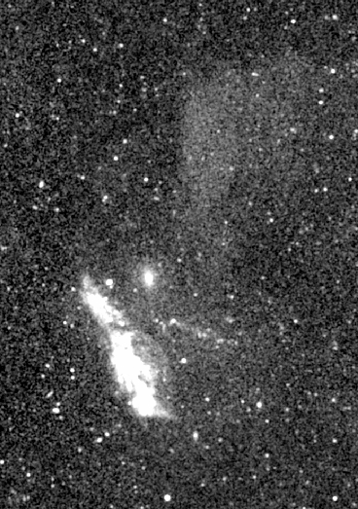
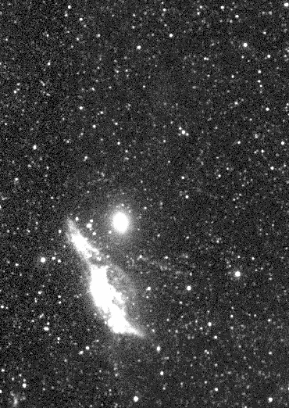
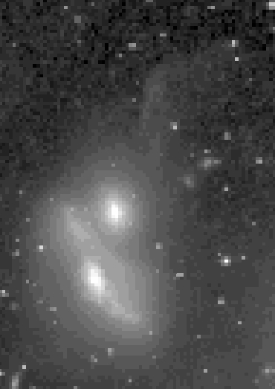
The First ICL Detection in the UV
FUV
FUV
NUV
V
N4438
5’
25Kpc

Slide 6
SED modeling
GALEX FUV & NUV and Schmidt B &V of high surface brightness part of plume.
3σ error bars from background fluctuations.
Model is a simple stellar population with instantaneous burst.
Monte carlo errors on Age and extinction.
Band | Detection
FUV | 15σ
NUV | 1σ
B | 13σ
V | 11σ

Slide 7
SED Implies ICL is Both Young and Dusty
IC stars are not well mixed (Williams et al 2007).
We have to date only evidence for a ubiquitous, old population (Krick et al. 2007, Feldmeier et al. 2004, Gonzalez et al. 2005, Zibetti et al. 2005).
The age of this plume is less than SNe timescales which implies there will be IC SNe events which will directly deposit metals into the ICM.
We are one step closer to a complete mass census of the intracluster population.
What other populations are we missing?

Slide 8
SED Implies ICL is Both Young and Dusty
Dust escapes galaxies by ram pressure stripping, SNe, tides.
Dust is destroyed by sputtering in the hot ICM.
Currently no direct detections of dust (Bai et al 2007, Kitayama et al 2009, Giard et al 2008).
Indirect evidence:
Extraplanar 8μm emission (Kenney et al. 2009 ).
Large visual extinctions of objects behind clusters (Maoz et al 1995).
Implications for interpreting observations at high redshift.
Gas/Dust ratio can inform physical models of the IC environment.

Slide 9
What is the full picture in Virgo?
Oosterloo & van Gorkom 2005
Red = Hα white = HI
Kenney et al., 2008

Slide 10
Future Work
Warm Spitzer: Are we missing old, low mass stellar populations?
GALEX proposal to look for other young, dusty populations

Slide 11
Conclusions: A Full Census
Stars; old and young
First detection of ICL in the UV.
Unprecedented coverage of the UV to IR SED constraining the relative ages and origins of the ICL.
Accurately measure the stellar mass of the ICL population, constraining chemical enrichment models of the ICM.
Dust
Potential first detection of dust in the ICL.
Inform hierarchical formation models and studies of high-z’s.
Gas
Search for stellar counterparts to gas streams.
Put together all the clues to understand the physical mechanisms at play in the center of the Virgo cluster.

