Slide 1
CO View of Molecular Gas around AGNs
Academia Sinica
Institute of Astronomy & Astrophysics
Satoki MATSUSHITA
Richard C.-Y. Chou, Daniel Espada, Pei-Ying Hsieh, Jeremy Lim, Sebastien Muller, Nagisa Oi,
Meng-Chun Tsai, & Dinh-Van-Trung

Slide 2
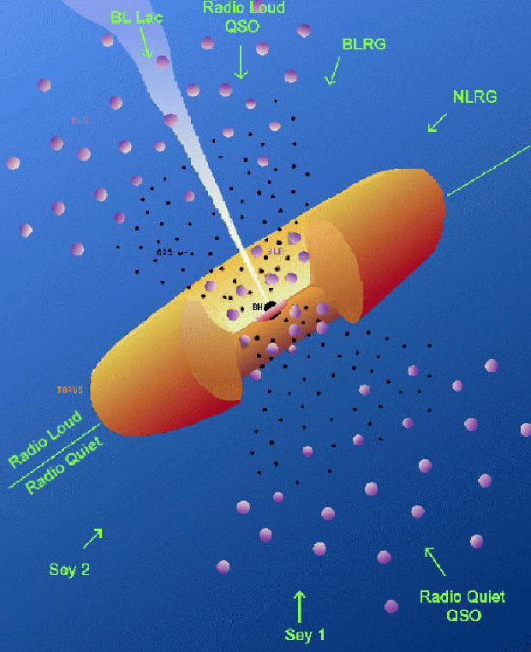
Introduction
Active Galactic Nuclei (AGNs)
What is the physical
conditions?
Really torus exist?
What is the size of torus?
What is the structure of torus?
Urry & Padovani

Slide 3
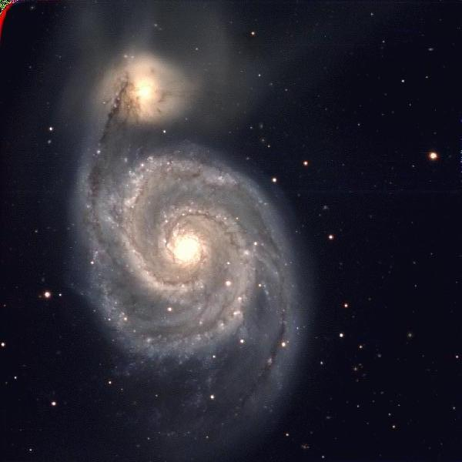
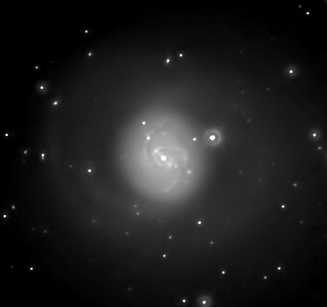
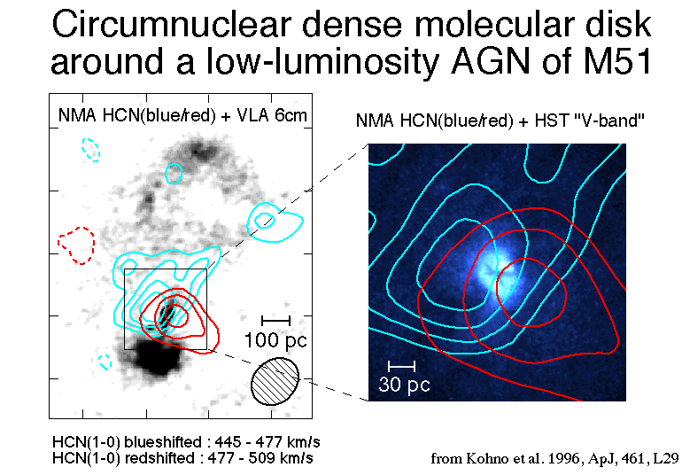
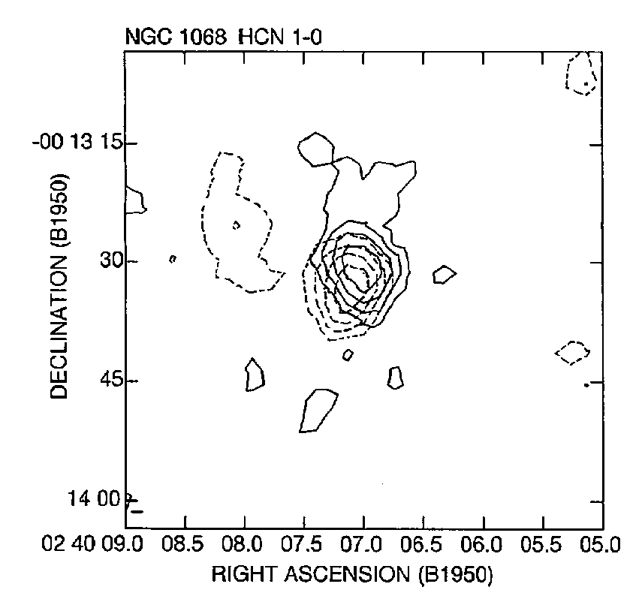
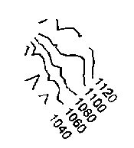
Search for Thick Tori/Disks
Seyfert 2 Galaxies NGC 1068 & M51
Molecular gas around AGNs in a few hundred pc scale images.
NGC 5194 (M51)
NGC 1068 (M77)
Dashed lines are blueshifted,
and solid lines are redshifted.
Isaac Newton Telescope INT-WFC
Kopernik Space Images
Rotation axis
||
Radio jet axis
350 pc
Jackson et al. 1993, ApJ, 418, L13
Kohno et al. 1996, ApJ, 461, L29

Slide 4
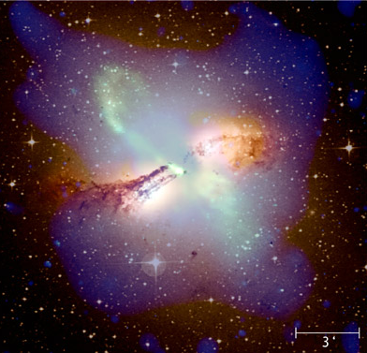
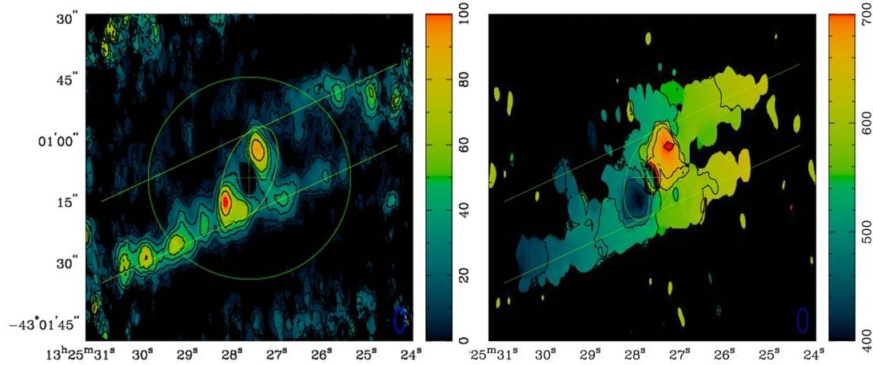
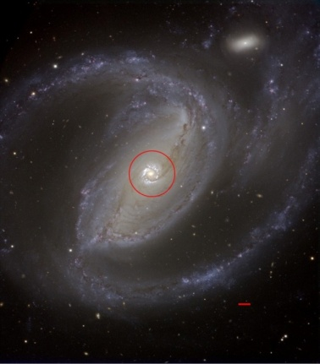
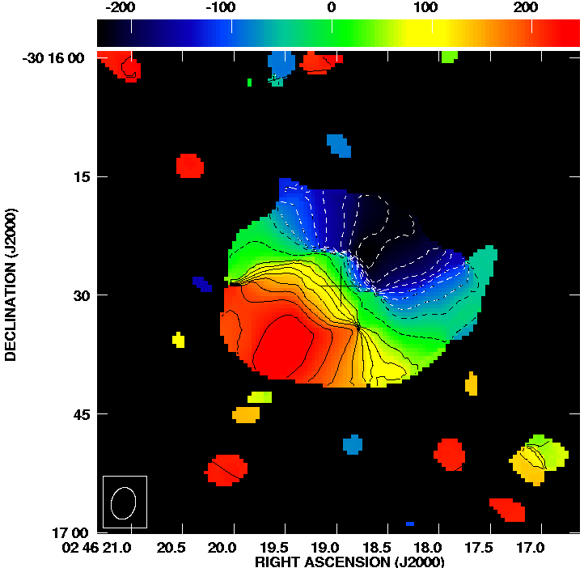
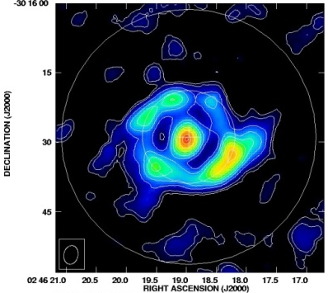
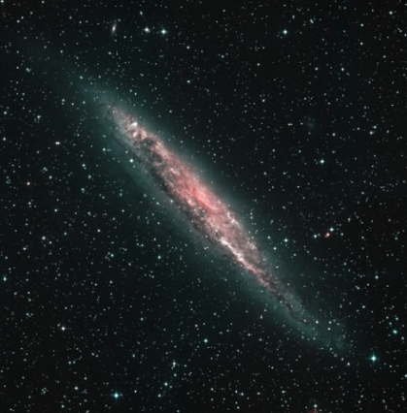
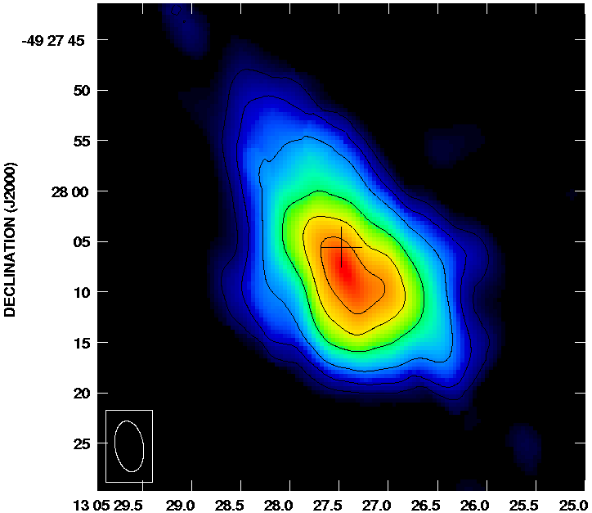
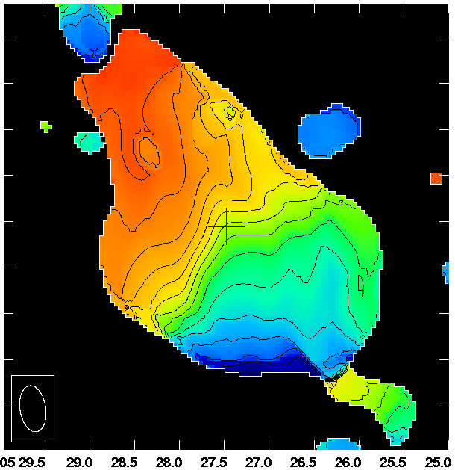
A Few 100 pc Scale Circum-AGN CO
Centaurus A (Radio Galaxy)
SMA ¹²CO(2-1)
Velocity Field
200 pc
Espada et al. 2009
ApJ, 695, 116
DSS Optical
Radio con. 1.4 GHz
HI 21 cm
X-ray Chandra
NGC 1097 (Sy 1)
SMA ¹²CO(2-1)
200 pc
Hsieh et al. 2008
ApJ, 683, 70
1 kpc
Velocity Field
VLT MELIPAL + VIMOS
NGC 4945 (Sy 2)
SMA ¹²CO(2-1)
200 pc
Chou et al. 2007, ApJ, 670, 116
ESO/MPI
Velocity Field

Slide 5
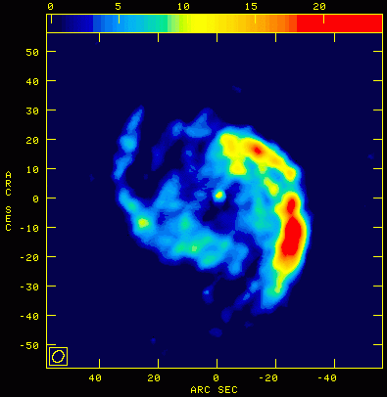
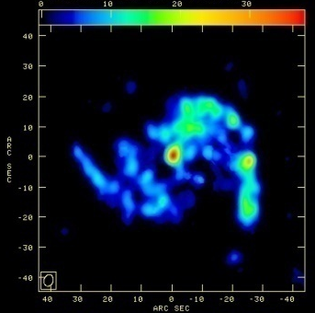
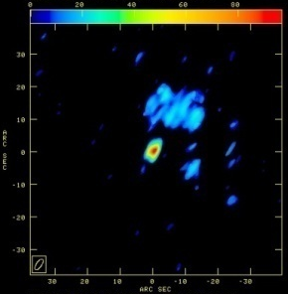
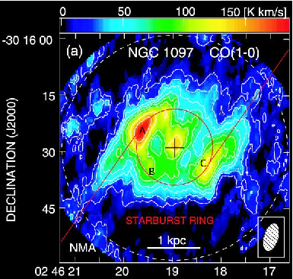

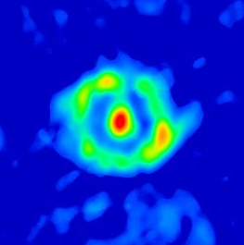
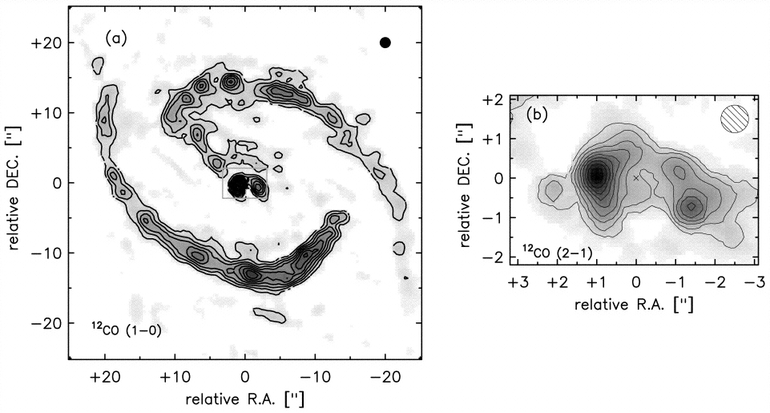
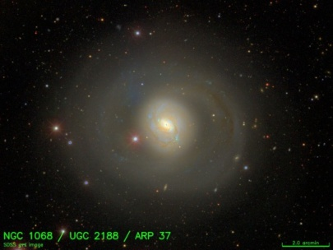
Multi-J CO Observations of AGNs
¹²CO(1-0)
¹²CO(2-1)
¹²CO(3-2)
NGC 5194 (Sy 2)
810 pc
Isaac Newton Telescope INT-WFC
Sakamoto et al. 1999,
ApJS, 124, 403
Matsushita et al. 2004,
ApJL, 616, L55
NGC 1097 (Sy 1)
1 kpc
1 kpc
Kohno et al. 2003,
PASJ, 55, L1
Hsieh et al. 2008,
ApJ, 683, 70
VLT MELIPAL + VIMOS
Oi, et al., in prep.
NGC 1068 (Sy 2)
SDSS
Schinnerer et al. 2000, ApJ, 533, 850
M.-C. Tsai et al.,
in prep.

Slide 6
Imaging Molecular Gas around AGNs at A Few Hundred pc Resolution
What is the physical
conditions?
Detected ones seem
warm (> 100 K) and
dense (~10⁴⁻⁵ cm⁻³).
< a few 100 pc
Really torus exist?
Highly likely yes.
What is the size?
< a few 100 pc.
What is the structure?
Rotating Disk or Torus.
Urry & Padovani

Slide 7
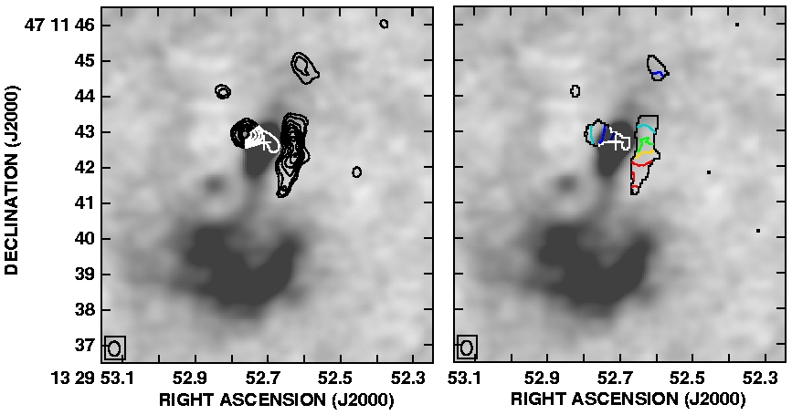
Imaging Molecular Gas around the AGN in M51 at ~10 pc Resolution
PdBI CO(2-1) + 6 cm Continuum
S2
S1
5”
Matsushita et al.
2007
A&A, 468, L49
Kohno et al. 1996 ApJ, 461, L29
Velocity Field
No clear torus/disk structure.
  Several ~ 10-20 pc size molecular clouds.
  No strong emission toward the nucleus.
Complicated velocity structure.
  Cloud S1: Velocity gradient toward north-south.
  Cloud S2: Velocity gradient toward east-west, but opposite sense as the previous observations.

Slide 8
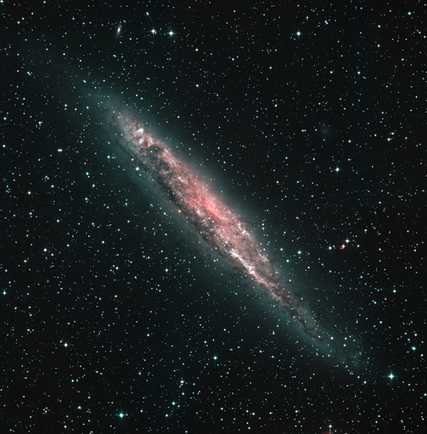
Imaging Molecular Gas around the AGN in NGC 4945 at ~20 pc Resolution
SMA ¹²CO(2-1) + Paα
40 pc
Velocity Field
ESO/MPI
Lim et al., submitted to ApJ
Compact (r ~ 20 pc), rotating molecular gas disk/torus inside the starburst ring.

Slide 9
Imaging Molecular Gas around AGNs at 10-20 pc Resolution
~ 10-20 pc or smaller ??
Really torus exist?
Not sure…
What is the size?
10-20 pc or smaller??
What is the structure?
Some has rotating disk/torus,
some can be messy…
Urry & Padovani

Slide 10
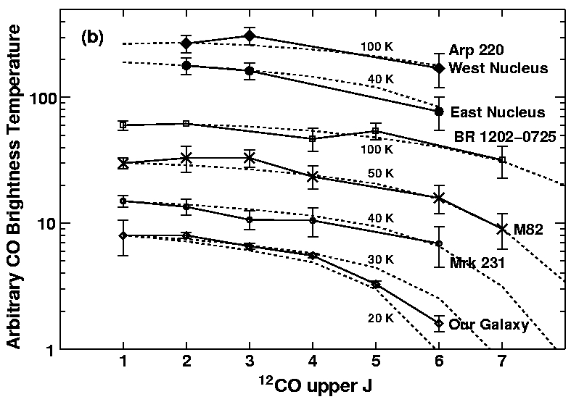
Star Formation in Circum-AGN Gas?
Line ratio point of view:
  CO line ratios of molecular gas near AGNs are much higher (> 1) than that in starburst galaxies.
    Due to the AGN heating?
  i
  Star formation is less likely.
NGC 1097
M51
Matsushita et al. 2009, ApJ, 693, 568

Slide 11
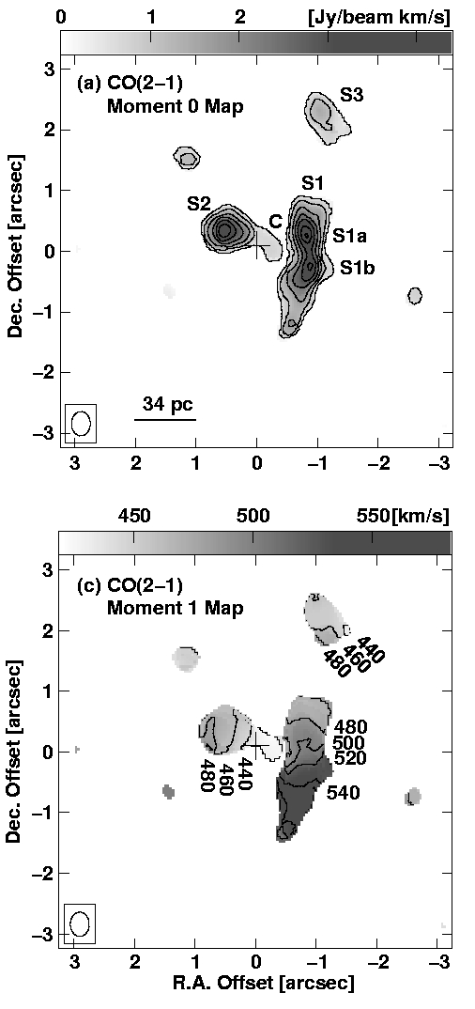
Star Formation in Circum-AGN Gas?
Gas stability point of view (case study with M51) :
  H₂ Gas Mass
      Assumption: Xco = 3.0 x 10²⁰ H₂ cm⁻² (K km/s)⁻¹
    Μ_{H2,S1a} = 1.4 x 10⁶ Mo
    M_{H2,S1b} = 1.3 x 10⁶ Mo
    M_{H2,S2} = 1.2 x 10⁶ Mo
  Virial Mass
    M_{vir,S1a} = 2.7 x 10⁶ Mo
    M_{vir,S1b} = 3.4 x 10⁶ Mo
    M_{vir,S2} = 2.2 x 10⁶ Mo
M_{vir} ~ (2-3) x M_{H2}
  Velocity dispersion is large (~ 30 km/s; radius ~ 10 pc)
    Due to jet from the AGN?
  For smaller X_{CO}, which is often seen in nearby galaxies, the discrepancy gets larger.
  Similar results as GMCs in the Galactic Center (e.g., Oka et al. 2001)
  Gas is stable against star formation.
Gas can fuel the AGN, if there is some mechanism to bring gas down to the AGN.
Moment 2 Map
(velocity dispersion)
30 km/s

Slide 12
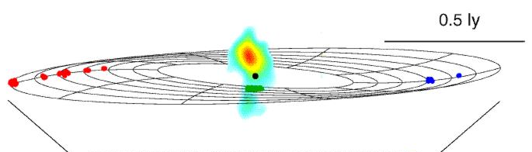
Molecular Gas around AGN in ALMA era
Current linked arrays:
~10 pc resolution
40 pc
~1 pc resolution
  Gas inflow from ~10 pc to < 1 pc.
  Star formation very close to AGNs.
  Gas outflow by jets/supernovae.
ALMA
Current VLBI:
~0.1 pc resolution
0.5 pc

Slide 13
Summary
At a few hundred pc scale, molecular gas around AGNs seems to have rotating disk-like structures.
At ~ 10 – 20 pc scale, NGC 4945 still has a rotating disk/torus-like structure, but M51 has very disturbed structure.
Intensity ratios between higher-J CO lines and J=1-0 are high (>1), suggesting different molecular gas characteristics from the gas in disk regions of galaxies.
Virial masses exceed molecular gas mass in M51, suggesting that the molecular gas near the AGN is stable against star formation.

